Slide 1


Unit – 4
Advanced Matrix Algebra
B.Tech. $→$1st Semester
Mathematics – I (2601HS101)
Course Outcome:
At the end of this unit, students will be able to carry out matrix analysis using eigenvectors and quadratic forms.

Slide 2

Topics of Unit 4
  Eigenvalues and Eigenvectors
  Algebraic Multiplicity and Geometric Multiplicity
  Cayley – Hamilton Theorem
  Diagonalization of Matrices
  Quadratic Forms and Canonical Forms
Looping

Slide 3

Outline of Unit 4
  Eigenvalues and Eigenvectors
  Algebraic Multiplicity and Geometric Multiplicity
  Cayley – Hamilton Theorem
  Diagonalization of Matrices
  Quadratic Forms and Canonical Forms
Looping

Slide 4
Introduction

Slide 5
Introduction
In this unit, we explore some advanced concepts of matrix algebra that help us understand the behavior of matrices more deeply.
The concepts of eigenvalues and eigenvectors describe special directions that remain unchanged under a linear transformation, except for a change in scale.

Slide 6
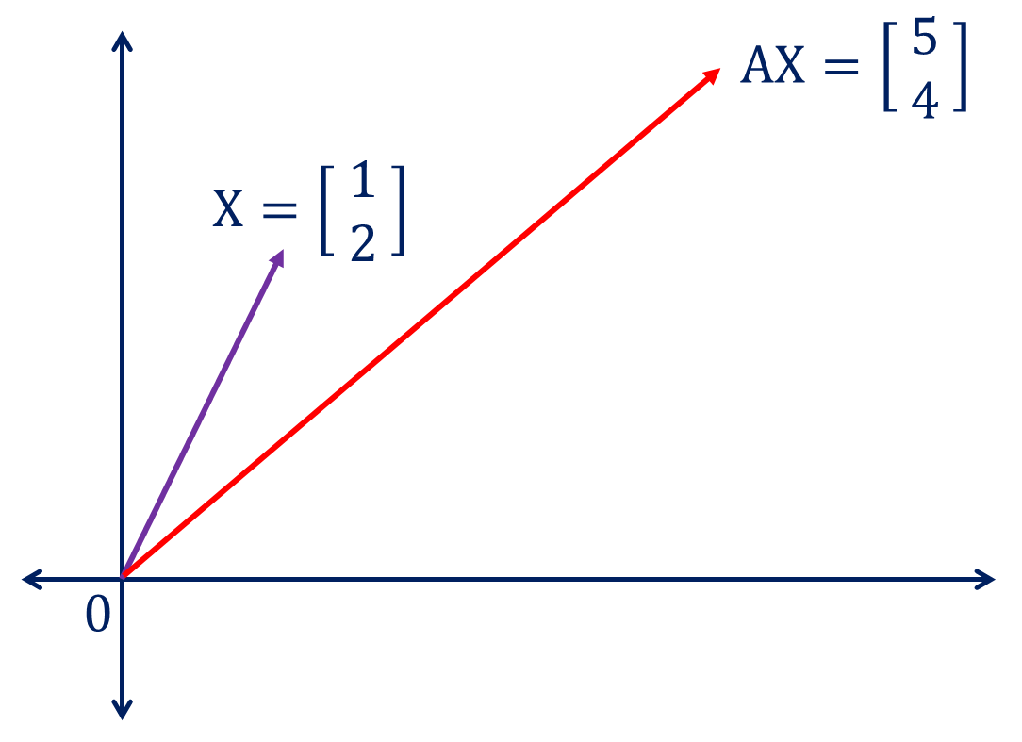
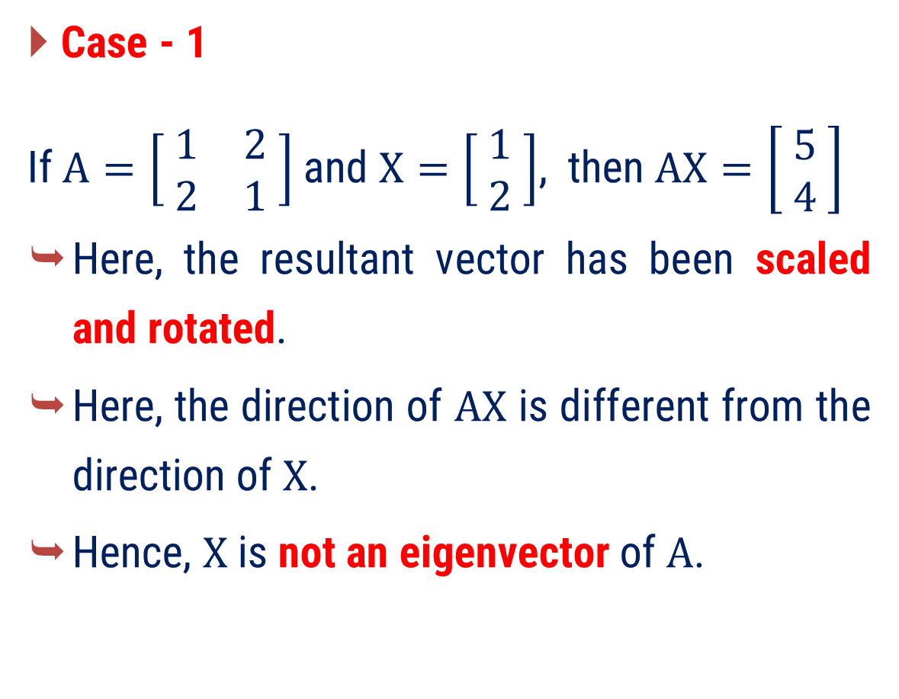
Introduction
Case - 1
If $A=\left[ \begin{matrix}1 & 2 \\ 2 & 1\end{matrix} \right]$and $X=\left[ \begin{matrix}1 \\ 2\end{matrix} \right]$, then $AX=\left[ \begin{matrix}5 \\ 4\end{matrix} \right]$
  Here, the resultant vector has been scaled and rotated.
  Here, the direction of $AX$ is different from the direction of $X$.
  Hence, $X$ is not an eigenvector of $A$.

Slide 7
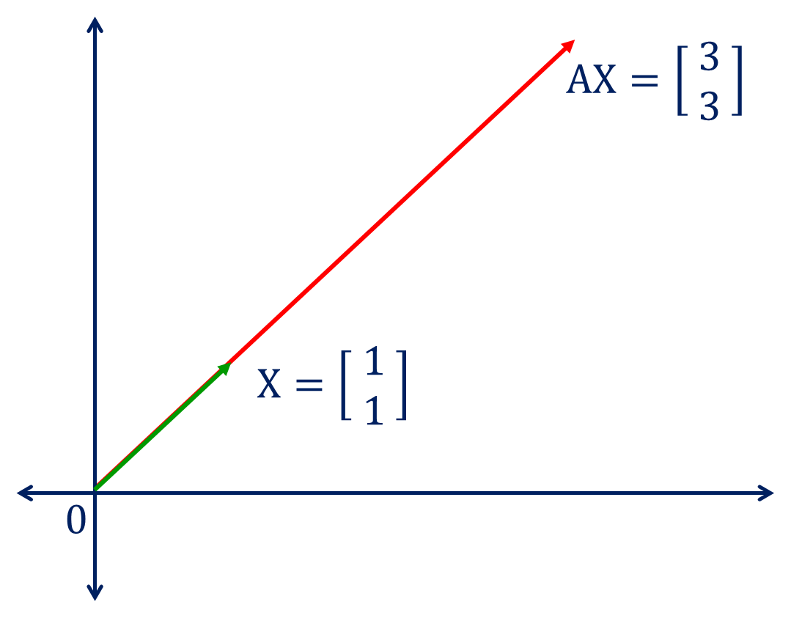
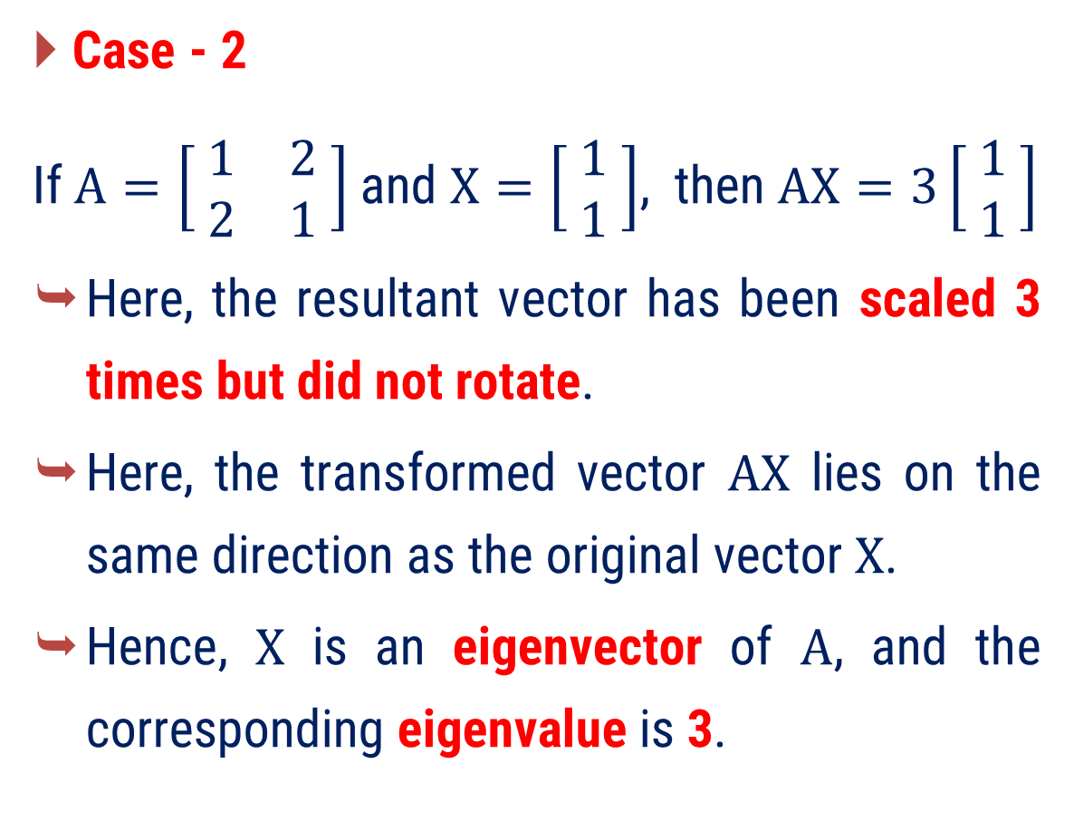
Introduction
Case - 2
If $A=\left[ \begin{matrix}1 & 2 \\ 2 & 1\end{matrix} \right]$and $X=\left[ \begin{matrix}1 \\ 1\end{matrix} \right]$, then $AX=3\left[ \begin{matrix}1 \\ 1\end{matrix} \right]$
  Here, the resultant vector has been scaled 3 times but did not rotate.
  Here, the transformed vector $AX$ lies on the same direction as the original vector $X$.
  Hence, $X$ is an eigenvector of $A$, and the corresponding eigenvalue is 3.

Slide 8
Introduction
Cayley-Hamilton Theorem, which establishes a fundamental link between a matrix and its characteristic equation.
We will learn about quadratic forms and canonical forms, which provide simpler representations of matrices and help in solving complex problems efficiently.
Eigenvalues and eigenvectors are widely used in Artificial Intelligence, Machine Learning, data analysis, image processing, and pattern recognition.

Slide 9
Method-1
Eigenvalues and Eigenvectors

Slide 10
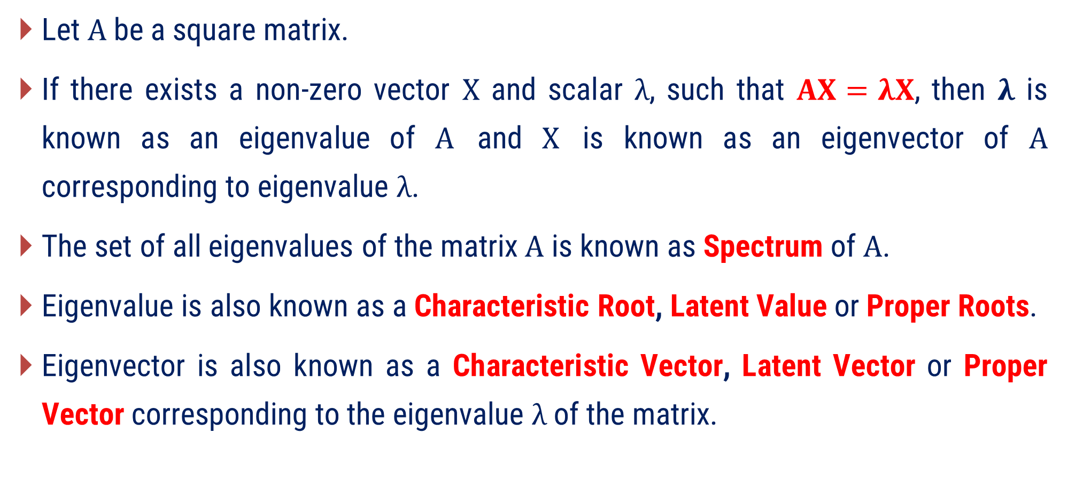
Eigenvalue & Eigenvector
Let $A$ be a square matrix.
If there exists a non-zero vector $X$ and scalar $λ$, such that $AX=λX$, then $λ$ is known as an eigenvalue of $A$ and $X$ is known as an eigenvector of $A$ corresponding to eigenvalue $λ$.
The set of all eigenvalues of the matrix $A$ is known as Spectrum of $A$.
Eigenvalue is also known as a Characteristic Root, Latent Value or Proper Roots.
Eigenvector is also known as a Characteristic Vector, Latent Vector or Proper Vector corresponding to the eigenvalue $λ$ of the matrix.

Slide 11
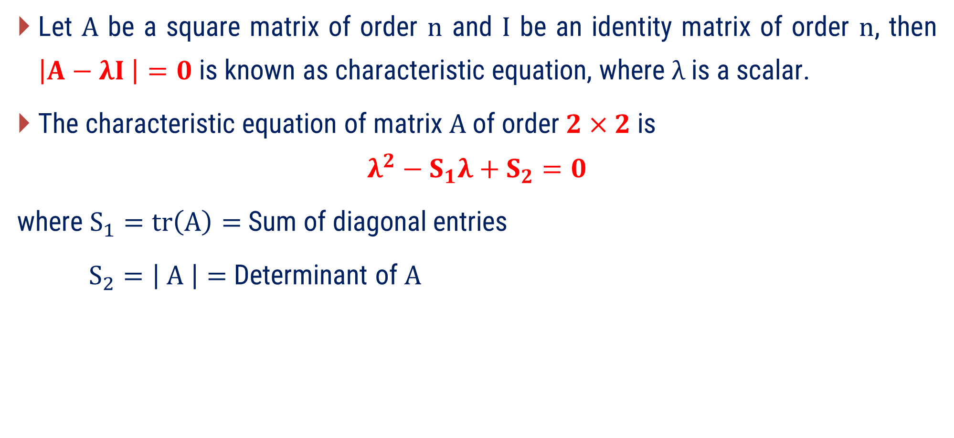
Characteristic Equation
Let $A$ be a square matrix of order $n$ and $I$ be an identity matrix of order $n$, then $\left|A−λI \right|=0$ is known as characteristic equation, where $λ$ is a scalar.
The characteristic equation of matrix $A$ of order $2×2$ is
$$λ^{2}−S_{1}λ+S_{2}=0$$
where $S_{1}=tr\left(A\right)=$ Sum of diagonal entries
$S_{2}=\left| A \right|=$ Determinant of $A$

Slide 12
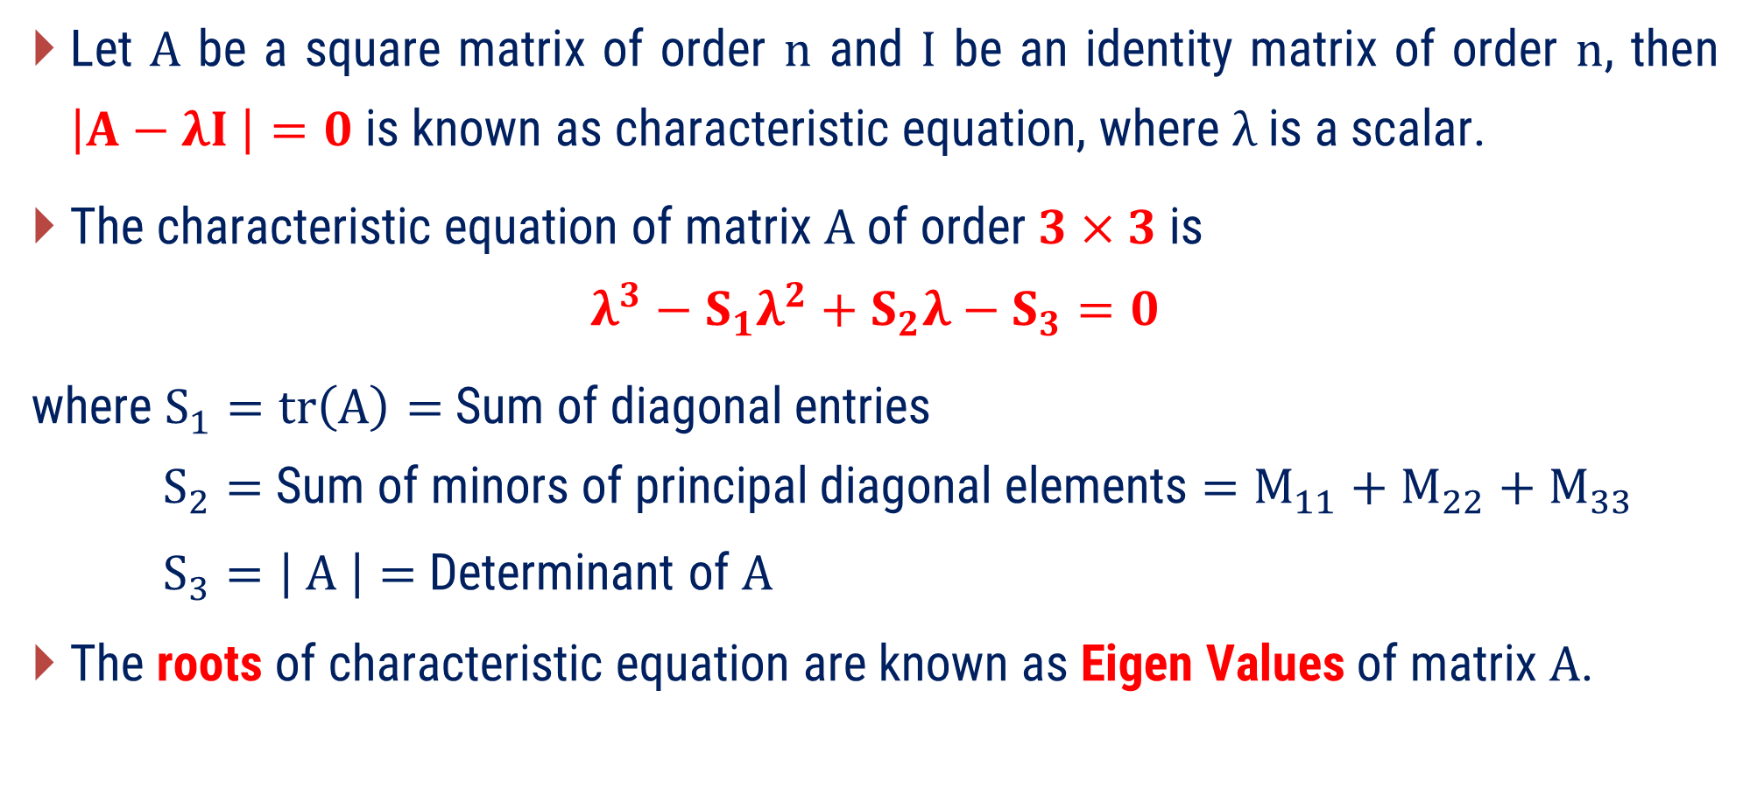
Characteristic Equation
Let $A$ be a square matrix of order $n$ and $I$ be an identity matrix of order $n$, then $\left|A−λI \right|=0$ is known as characteristic equation, where $λ$ is a scalar.
The characteristic equation of matrix $A$ of order $3×3$ is
$$λ^{3}−S_{1}λ^{2}+S_{2}λ−S_{3}=0$$
where $S_{1}=tr\left(A\right)=$ Sum of diagonal entries
$S_{2}=$ Sum of minors of principal diagonal elements $=M_{11}+M_{22}+M_{33}$
$S_{3}=\left| A \right|=$ Determinant of $A$
The roots of characteristic equation are known as Eigen Values of matrix $A$.

Slide 13
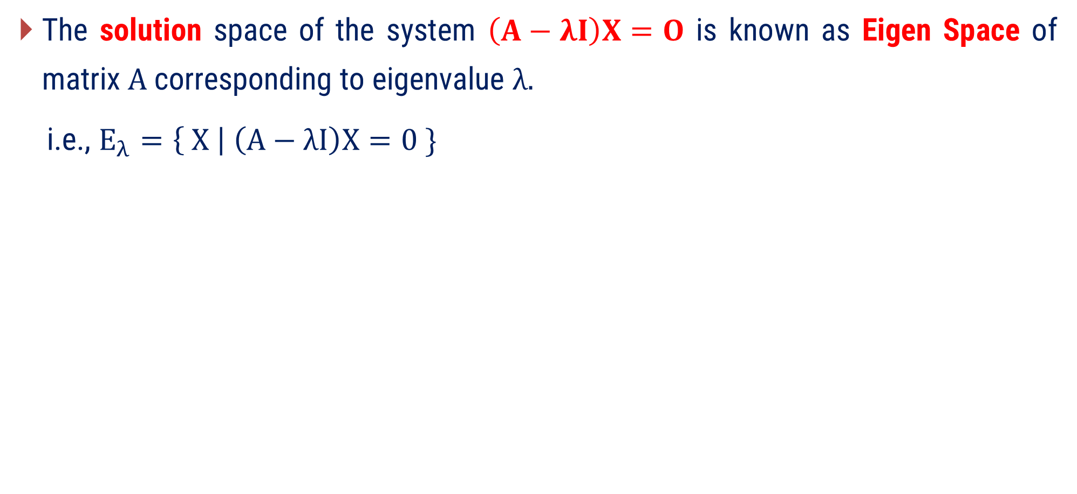
Eigen Space
The solution space of the system $\left(A−λI\right)X=O$ is known as Eigen Space of matrix $A$ corresponding to eigenvalue $λ.$
i.e., $E_{λ}=\left\{ X \right| \left(A−λI\right)X=0 \}$

Slide 14
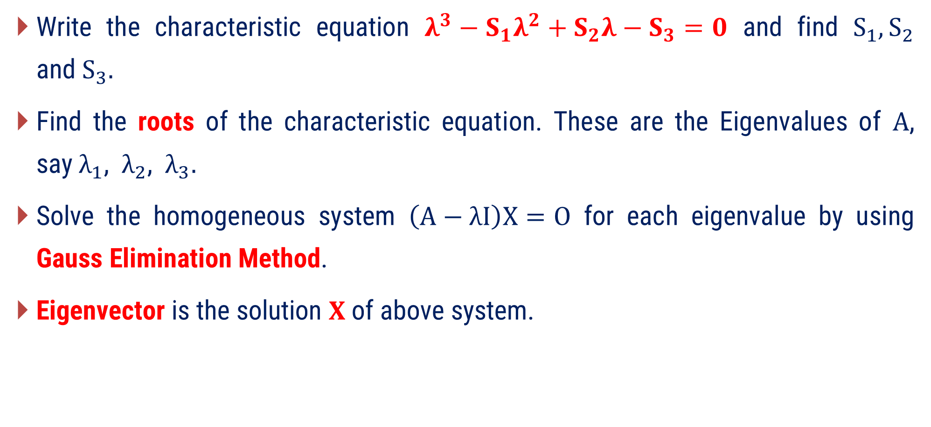
Procedure to Find the Eigen Value, Eigen Vector for $3×3$ matrix
Write the characteristic equation $λ^{3}−S_{1}λ^{2}+S_{2}λ−S_{3}=0$ and find $S_{1}, S_{2}$ and$S_{3}.$
Find the roots of the characteristic equation. These are the Eigenvalues of $A$, say$λ_{1}$, $λ_{2}$, $λ_{3}.$
Solve the homogeneous system $\left(A−λI\right)X=O$ for each eigenvalue by using Gauss Elimination Method.
Eigenvector is the solution $X$ of above system.
The procedure remains same for any matrix of order $n$.

Slide 15
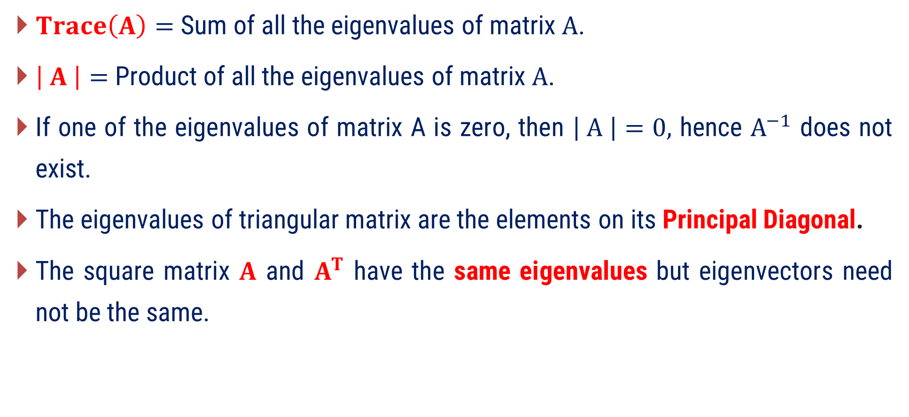
Properties of Eigenvalue and Eigenvector
$Trace\left(A\right)=$ Sum of all the eigenvalues of matrix $A$.
$\left| A \right|=$ Product of all the eigenvalues of matrix $A$.
If one of the eigenvalues of matrix A is zero, then $\left| A \right|=0,$ hence $A^{−1}$ does not exist.
The eigenvalues of triangular matrix are the elements on its Principal Diagonal.
The square matrix $A$ and $A^{T}$ have the same eigenvalues but eigenvectors need not be the same.

Slide 16
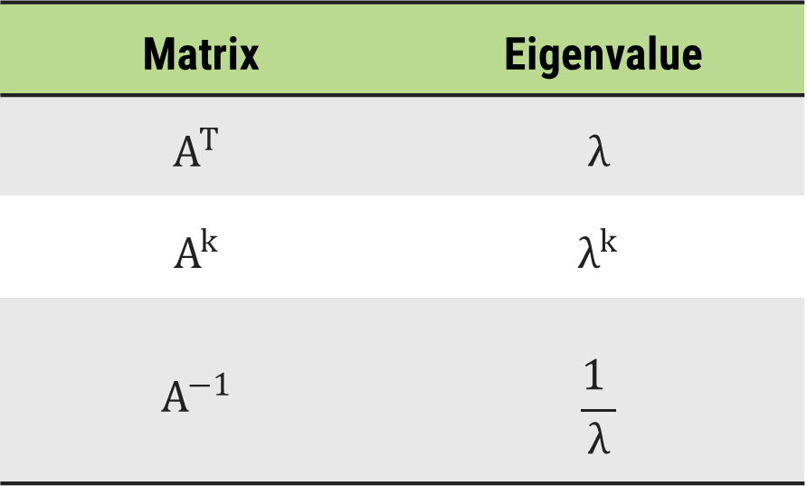
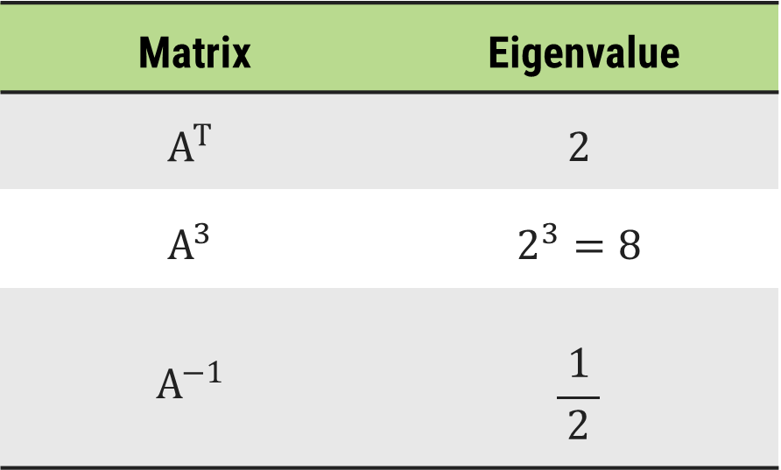

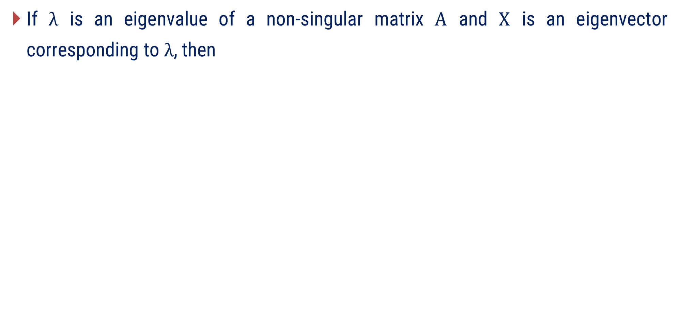
Properties of Eigenvalue and Eigenvector
If $λ$ is an eigenvalue of a non-singular matrix $A$ and $X$ is an eigenvector corresponding to $λ$, then
Let $2$ be the eigenvalue of Matrix $A$.
Matrix | Eigenvalue
Matrix | Eigenvalue

Slide 17
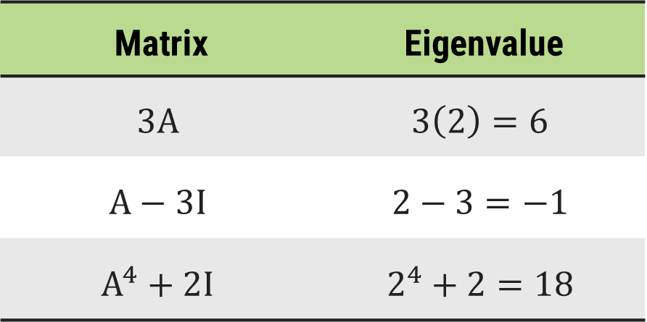
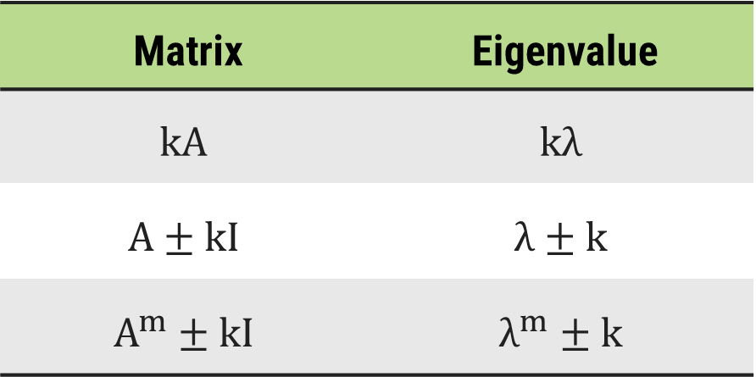

Properties of Eigenvalue and Eigenvector
If $λ$ is an eigenvalue of a non-singular matrix $A$ and $X$ is an eigenvector corresponding to $λ$, then
Let $2$ be the eigenvalue of Matrix $A$.
Matrix | Eigenvalue
Matrix | Eigenvalue
$$k∈ℝ$$

Slide 18










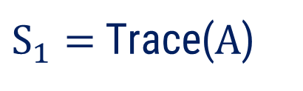




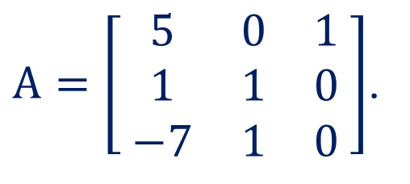



Method:1$⇝$Example:1
Example
Find the eigen values and corresponding eigen vectors of the matrix
$A=\left[ \begin{matrix}5 & 0 & 1 \\ 1 & 1 & 0 \\ −7 & 1 & 0\end{matrix} \right]$.
Solution
The characteristic equation of the matrix $A$ is given by
$$λ^{3}$$
$$− S_{1}λ^{2}$$
$$+ S_{2}λ$$
$$− S_{3}$$
$$=0$$
$$\left(1\right)$$
$S_{1}=$ Trace($A$)
$$=5+1+0$$
$$=6$$
$S_{2}=$ Sum of minors of principal diagonal elements
$$\left| \begin{matrix}1 & 0 \\ 1 & 0\end{matrix} \right|$$
$$\left| \begin{matrix}5 & 1 \\ −7 & 0\end{matrix} \right|$$
$$\left| \begin{matrix}5 & 0 \\ 1 & 1\end{matrix} \right|$$
$${⇒S}_{2} =$$
$$+$$
$$+$$
$$=0+7+5$$
$$=12$$

Slide 19




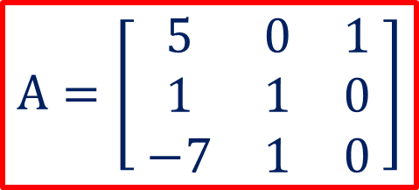




















Method:1$⇝$Example:1(Continue)
$$A=\left[ \begin{matrix}5 & 0 & 1 \\ 1 & 1 & 0 \\ −7 & 1 & 0\end{matrix} \right]$$
$${ S}_{3} =\left| A \right|$$
$$=0−0+1\left(1+7\right)$$
$$=8$$
From equation $\left(1\right)$, $λ^{3}− S_{1}λ^{2}+ S_{2}λ− S_{3}=0$
$$S_{1}=6 ; S_{2}=12$$
$$⇒λ^{3}−6 λ^{2}+12 λ−8=0$$
Try $λ=0, ±1, ±2, ±3$
$$⇒\left( λ−2 \right)\left( λ^{2}−4λ+4 \right)=0$$
$$⇒\left( λ−2 \right)\left( λ^{2}−4λ+4 \right)=0$$
$$\left( λ−2 \right)\left( λ−2 \right)=0$$
$$2$$
$$1 −6 12 −8$$
$$×$$
$$+$$
$$0$$
$$−8$$
$$8$$
$$⇒λ=2, 2, 2$$
$$1$$
$$−4$$
$$4$$
$$0$$
$$2×1=$$
$$2$$

Slide 20
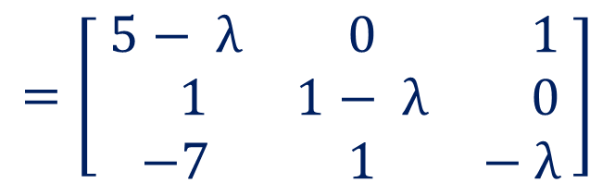

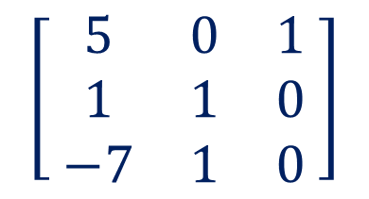
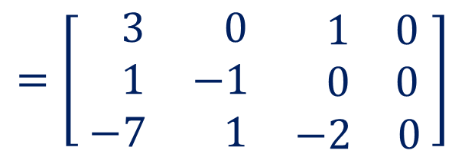


Method:1$⇝$Example:1(Continue)
To find eigenvector, consider the homogeneous system $\left(A−λI\right)X=O$.
$$\left[ \begin{matrix}5 & 0 & 1 \\ 1 & 1 & 0 \\ −7 & 1 & 0\end{matrix} \right]$$
$$− λ \left[ \begin{matrix}1 & 0 & 0 \\ 0 & 1 & 0 \\ 0 & 0 & 1\end{matrix} \right]$$
$$=\left[ \begin{matrix}5− λ & 0 & 1 \\ 1 & 1− λ & 0 \\ −7 & 1 & − λ\end{matrix} \right]$$
Here, matrix $A−λI=$
To get eigenvector for $λ=2$. We solve the system $\left(A−2I\right)X=O$.
$$=\left[ \begin{matrix} 3 & 0 & \begin{matrix} 1 & 0\end{matrix} \\ 1 & −1 & \begin{matrix} 0 & 0\end{matrix} \\ −7 & 1 & \begin{matrix}−2 & 0\end{matrix}\end{matrix} \right]$$
Consider, the Augmented Matrix, $\left[ A−2I | O \right]$

Slide 21
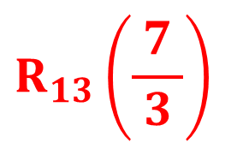
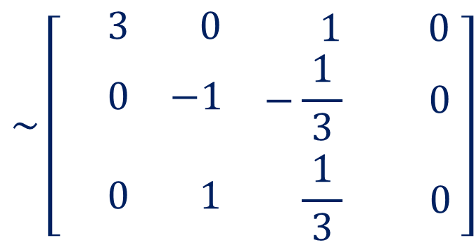
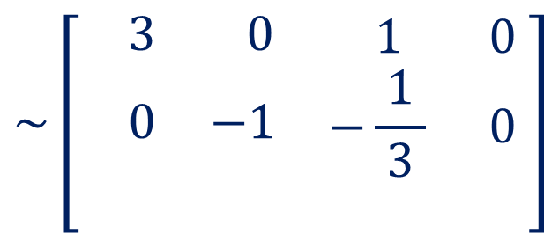
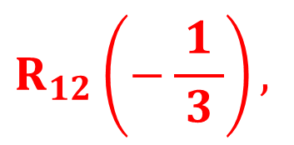
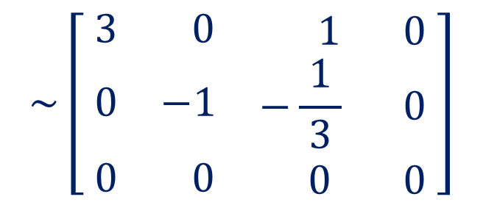
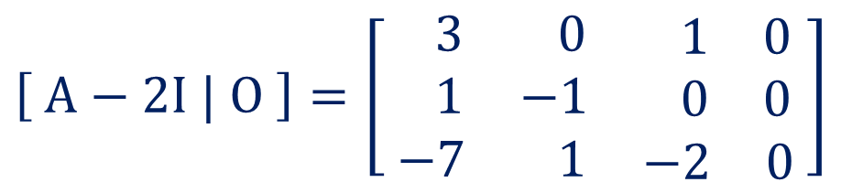

Method:1$⇝$Example:1(Continue)
$$R_{23}\left(1\right)$$
Consider, the Augmented Matrix,
$$\left[ A−2I | O \right]=\left[ \begin{matrix} 3 & 0 & \begin{matrix} 1 & 0\end{matrix} \\ 1 & −1 & \begin{matrix} 0 & 0\end{matrix} \\ −7 & 1 & \begin{matrix}−2 & 0\end{matrix}\end{matrix} \right]$$
$$\sim \left[ \begin{matrix}3 & 0 & \begin{matrix} 1 & 0\end{matrix} \\ 0 & −1 & \begin{matrix}−\frac{1}{ 3 } & 0\end{matrix} \\ 0 & 0 & \begin{matrix} 0 & 0\end{matrix}\end{matrix} \right]$$
$$R_{12}\left(−\frac{1}{ 3 }\right),$$
$$R_{13}\left(\frac{7}{ 3 }\right)$$
$$\sim \left[ \begin{matrix} 3 & 0 & \begin{matrix} 1 & 0\end{matrix} \\ 0 & −1 & \begin{matrix}−\frac{1}{ 3 } & 0\end{matrix} \\ 0 & 1 & \begin{matrix}−\frac{1}{ 3 } & 0\end{matrix}\end{matrix} \right]$$
$$\sim \left[ \begin{matrix} 3 & 0 & \begin{matrix} 1 & 0\end{matrix} \\ 0 & −1 & \begin{matrix}−\frac{1}{ 3 } & 0\end{matrix} \\ −7 & 1 & \begin{matrix}−2 & 0\end{matrix}\end{matrix} \right]$$

Slide 22
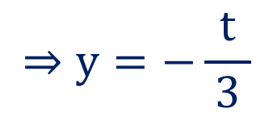


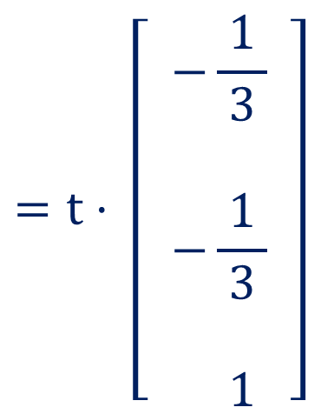
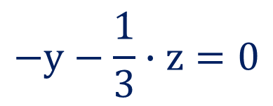
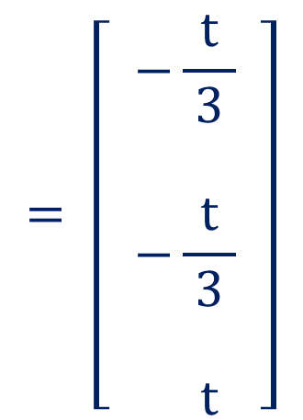

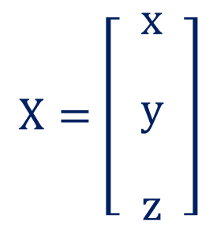
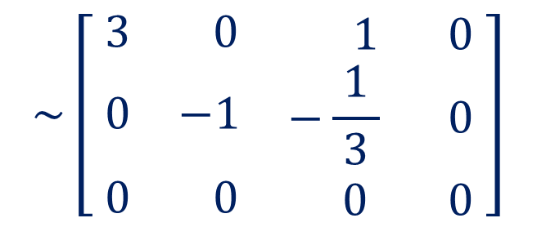
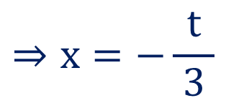
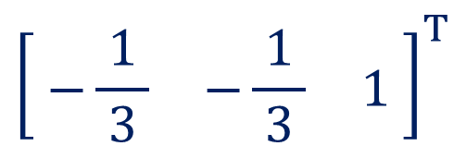
Method:1$⇝$Example:1(Continue)
Now,
$$\sim \left[ \begin{matrix}3 & 0 & \begin{matrix} 1 & 0\end{matrix} \\ 0 & −1 & \begin{matrix}−\frac{1}{ 3 } & 0\end{matrix} \\ 0 & 0 & \begin{matrix} 0 & 0\end{matrix}\end{matrix} \right]$$
$$=t⋅ \left[ \begin{matrix}\begin{aligned}−\frac{1}{ 3 } \\ \end{aligned} \\ \begin{aligned}−\frac{1}{ 3 } \\ \end{aligned} \\ 1\end{matrix} \right]$$
$$= \left[ \begin{matrix}\begin{aligned}−\frac{t}{ 3 } \\ \end{aligned} \\ \begin{aligned}−\frac{t}{ 3 } \\ \end{aligned} \\ t\end{matrix} \right]$$
$$X=\left[ \begin{matrix}\begin{aligned}x \\ \end{aligned} \\ \begin{aligned}y \\ \end{aligned} \\ z\end{matrix} \right]$$
Let, $z=t ; t∈ ℝ$
$$−y−\frac{1}{3}∙z=0$$
$$⇒y=−\frac{t}{ 3 }$$
$$; t∈ ℝ$$
$$⇒x=−\frac{t}{ 3 }$$
$$3x+z=0$$
$${\left[ \begin{matrix}−\frac{1}{ 3 } & −\frac{1}{ 3 } & 1\end{matrix} \right]}^{T}$$
So, eigenvector is

Slide 23
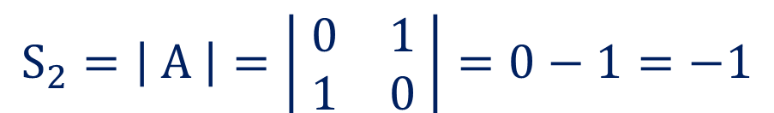


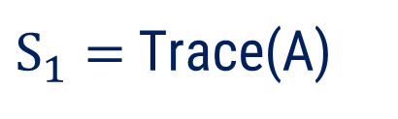
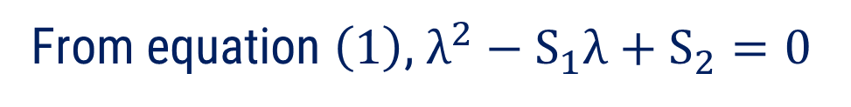
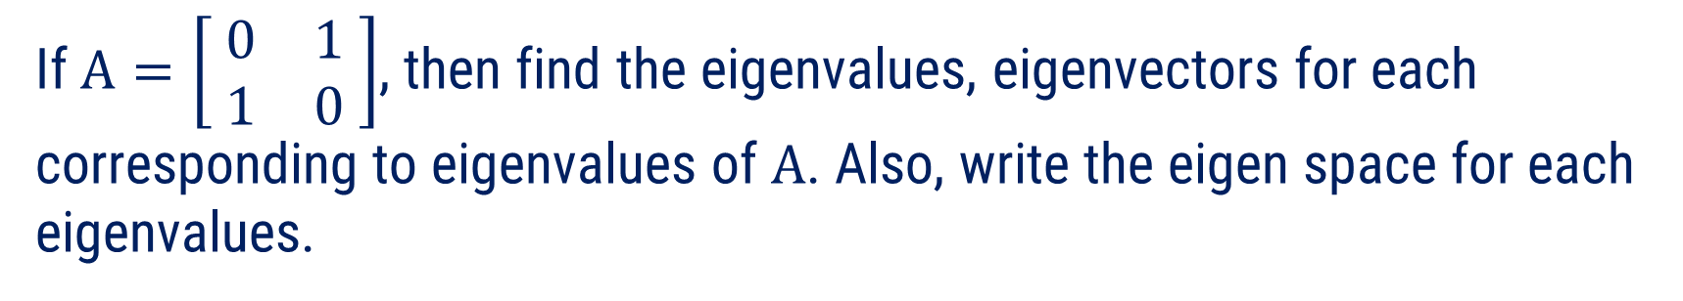

Method:1$⇝$Example:2
Example
If $A=\left[ \begin{matrix}0 & 1 \\ 1 & 0\end{matrix} \right]$, then find the eigenvalues, eigenvectors for each corresponding to eigenvalues of $A$. Also, write the eigen space for each eigenvalues.
Solution
The characteristic equation of the matrix $A$ is given by
$$λ^{2}−S_{1}λ+S_{2}=0$$
$$\left(1\right)$$
$S_{1}=$ Trace(A)
$$=0$$
$$S_{2}=\left| A \right|=\left| \begin{matrix}0 & 1 \\ 1 & 0\end{matrix} \right|=0−1=−1$$
From equation $\left(1\right)$, $λ^{2}−S_{1}λ+S_{2}=0$

Slide 24

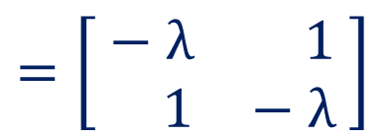

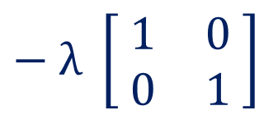






Method:1$⇝$Example:2(Continue)
From equation $\left(1\right)$, $λ^{2}−S_{1}λ+S_{2}=0$
$$S_{1}=0 ; S_{2}=−1$$
$$⇒λ^{2}−1=0$$
$$⇒λ=±1$$
To find eigenvector, consider the homogeneous system $\left(A−λI\right)X=O$.
$$\left[ \begin{matrix}0 & 1 \\ 1 & 0\end{matrix} \right]$$
$$− λ \left[ \begin{matrix}1 & 0 \\ 0 & 1\end{matrix} \right]$$
$$=\left[ \begin{matrix}− λ & 1 \\ 1 & − λ\end{matrix} \right]$$
Here, matrix $A−λI=$
To get eigenvector for $λ=1$. We solve the system $\left(A−I\right)X=O$.
$$=\left[ \begin{matrix}−1 & 1 & 0 \\ 1 & −1 & 0\end{matrix} \right]$$
Consider, the Augmented Matrix, $\left[ A−I | O \right]$

Slide 25

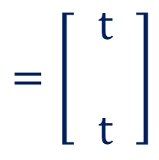

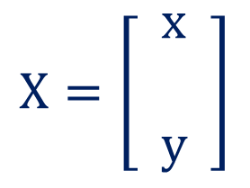










Method:1$⇝$Example:2(Continue)
Consider, the Augmented Matrix,
Now,
$$=\left[ \begin{matrix}−1 & 1 & 0 \\ 1 & −1 & 0\end{matrix} \right]$$
$$X=\left[ \begin{matrix}x \\ \\ y\end{matrix} \right]$$
$$=\left[ \begin{matrix}t \\ \\ t\end{matrix} \right]$$
$$=t⋅\left[ \begin{matrix}1 \\ \\ 1\end{matrix} \right]; t∈ ℝ$$
$\left[ A−I | O \right]$
$$R_{12}\left(1\right)$$
$$\sim \left[ \begin{matrix}−1 & 1 & 0 \\ 0 & 0 & 0\end{matrix} \right]$$
So, eigenvector is
$${\left[1 1\right]}^{T}.$$
Let, $y=t ; t∈ ℝ$
So, eigen space for $λ=1$ is
$$−x+y=0$$
$$E_{λ=1}=\left\{ \left[ \begin{matrix}\begin{aligned}1 \\ \end{aligned} \\ 1\end{matrix} \right]∙t | t∈ ℝ \right\}$$
$$⇒x=y$$
$$⇒x=t$$

Slide 26

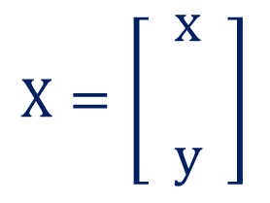













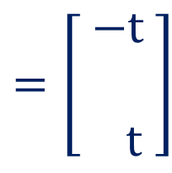
Method:1$⇝$Example:2(Continue)
To get eigenvector for $λ=−1$.
Now,
We solve the system $\left(A+I\right)X=O$.
$$X=\left[ \begin{matrix}x \\ \\ y\end{matrix} \right]$$
$$=\left[ \begin{matrix}−t \\ \\ t\end{matrix} \right]$$
$$=t⋅\left[ \begin{matrix}−1 \\ \\ 1\end{matrix} \right]; t∈ ℝ$$
$$=\left[ \begin{matrix}1 & 1 & 0 \\ 1 & 1 & 0\end{matrix} \right]$$
$\left[ A+I | O \right]$
$$R_{12}\left(−1\right)$$
So, eigenvector is
$${\left[−1 1\right]}^{T}.$$
$$\sim \left[ \begin{matrix}1 & 1 & 0 \\ 0 & 0 & 0\end{matrix} \right]$$
So, eigen space for $λ=−1$ is
$$E_{λ=1}=\left\{ \left[ \begin{matrix}\begin{aligned}−1 \\ \end{aligned} \\ 1\end{matrix} \right]∙t | t∈ ℝ \right\}$$
Let, $y=t ; t∈ ℝ$
$$x+y=0$$
$$A−λI=\left[ \begin{matrix}− λ & 1 \\ 1 & − λ\end{matrix} \right]$$
$$⇒x=−t$$

Slide 27




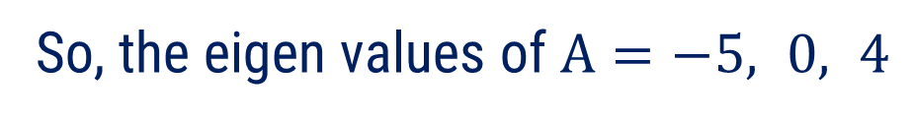

Method:1$⇝$Example:3
Find the eigen values of $A=\left[ \begin{matrix}−5 & 4 & 34 \\ 0 & 0 & 4 \\ 0 & 0 & 4\end{matrix} \right]$. Is $A$ invertible?
Example
Solution
The given matrix is an upper triangular matrix.
So, the eigen values of $A=−5, 0, 4$
Since, $\left| A \right|=$
$$−5×0×4=0$$
Hence, $A^{−1}$ does not exist.
So$, A$is not invertible.

Slide 28




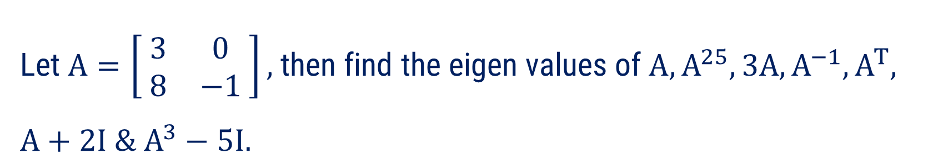


















Method:1$⇝$Example:4
Let $A=\left[ \begin{matrix}3 & 0 \\ 8 & −1\end{matrix} \right],$ then find the eigen values of $A, A^{25}, 3A, A^{−1}, A^{T},$
$$A+2I \& A^{3}−5I.$$
Example
Solution
The given matrix is an lower triangular matrix.
So, the eigen values of $A=3, −1$
Matrix
Eigen Values
Matrix
Eigen Values
$$A$$
$$3$$
$$−1$$
$$A^{T}$$
$$3$$
$$−1$$
$$A^{25}$$
$$3^{25}$$
$$−1$$
$$A+2I$$
$$5$$
$$1$$
$$3A$$
$$9$$
$$−3$$
$$A^{3}−5I$$
$$22$$
$$−6$$
$$A^{−1}$$
$$1/3$$
$$−1$$

Slide 29
Method-2
Cayley – Hamilton Theorem

Slide 30
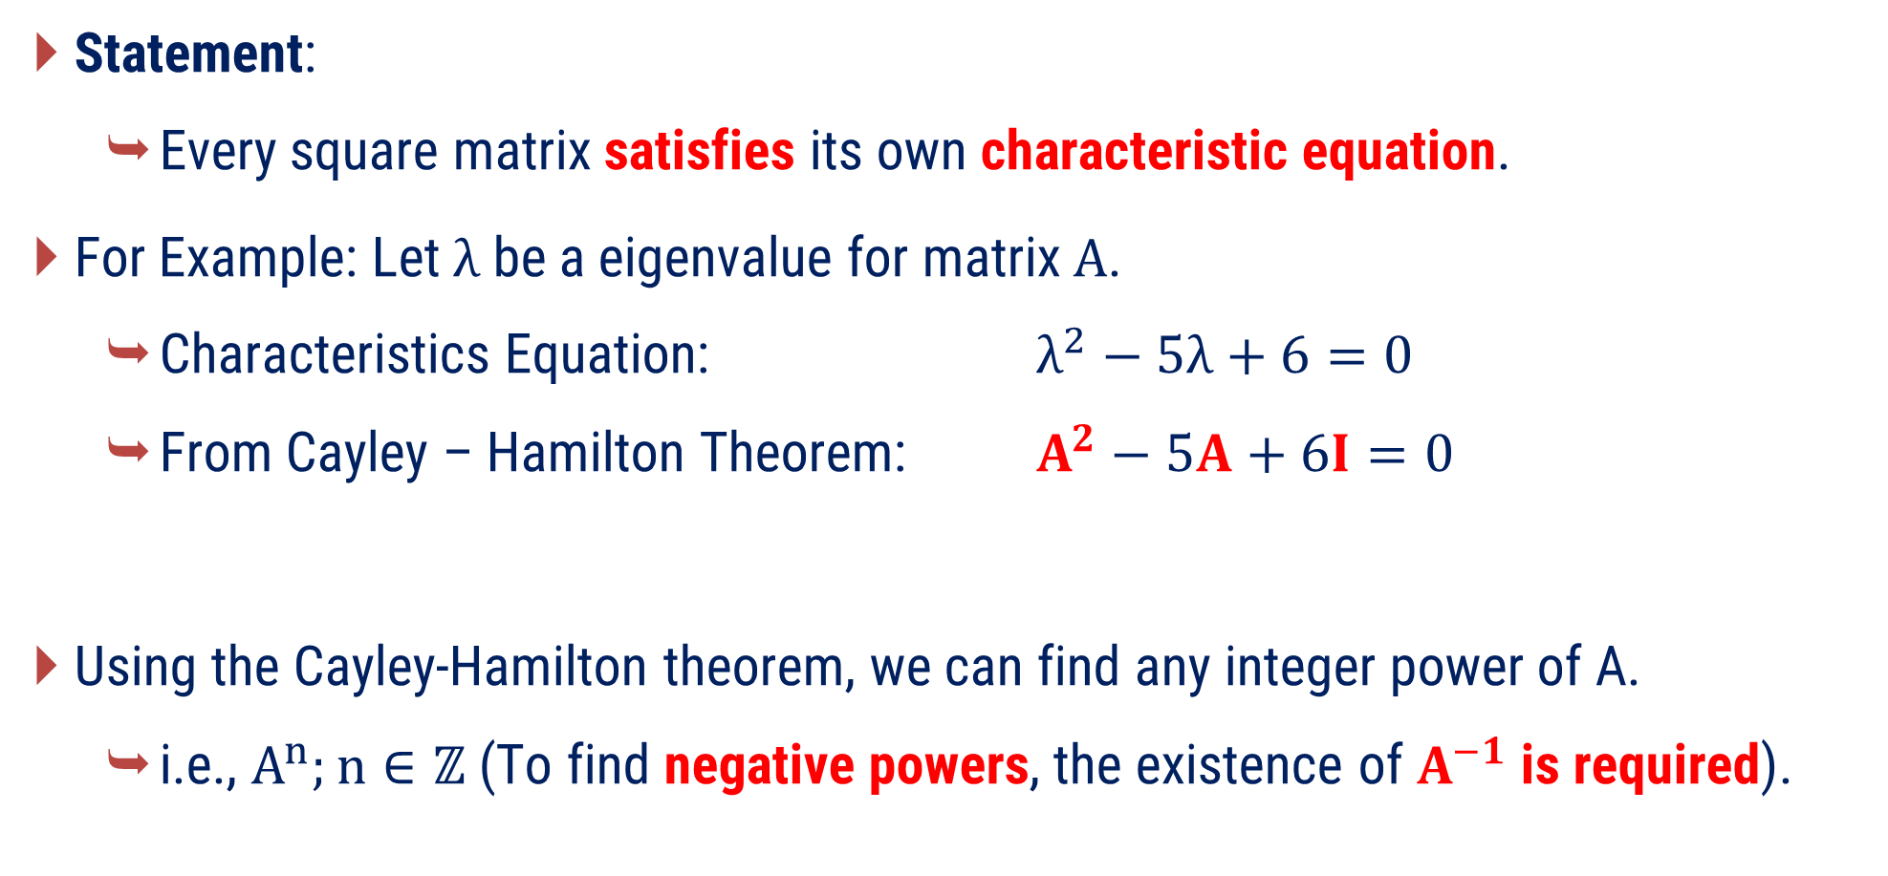
Cayley – Hamilton Theorem
Statement:
  Every square matrix satisfies its own characteristic equation.
For Example: Let $λ$ be a eigenvalue for matrix $A$.
  Characteristics Equation: $λ^{2}−5λ+6=0$
  From Cayley – Hamilton Theorem: $A^{2}−5A+6I=0$
Using the Cayley-Hamilton theorem, we can find any integer power of A.
  i.e., $A^{n};n∈ℤ$ (To find negative powers, the existence of $A^{−1}$ is required).

Slide 31
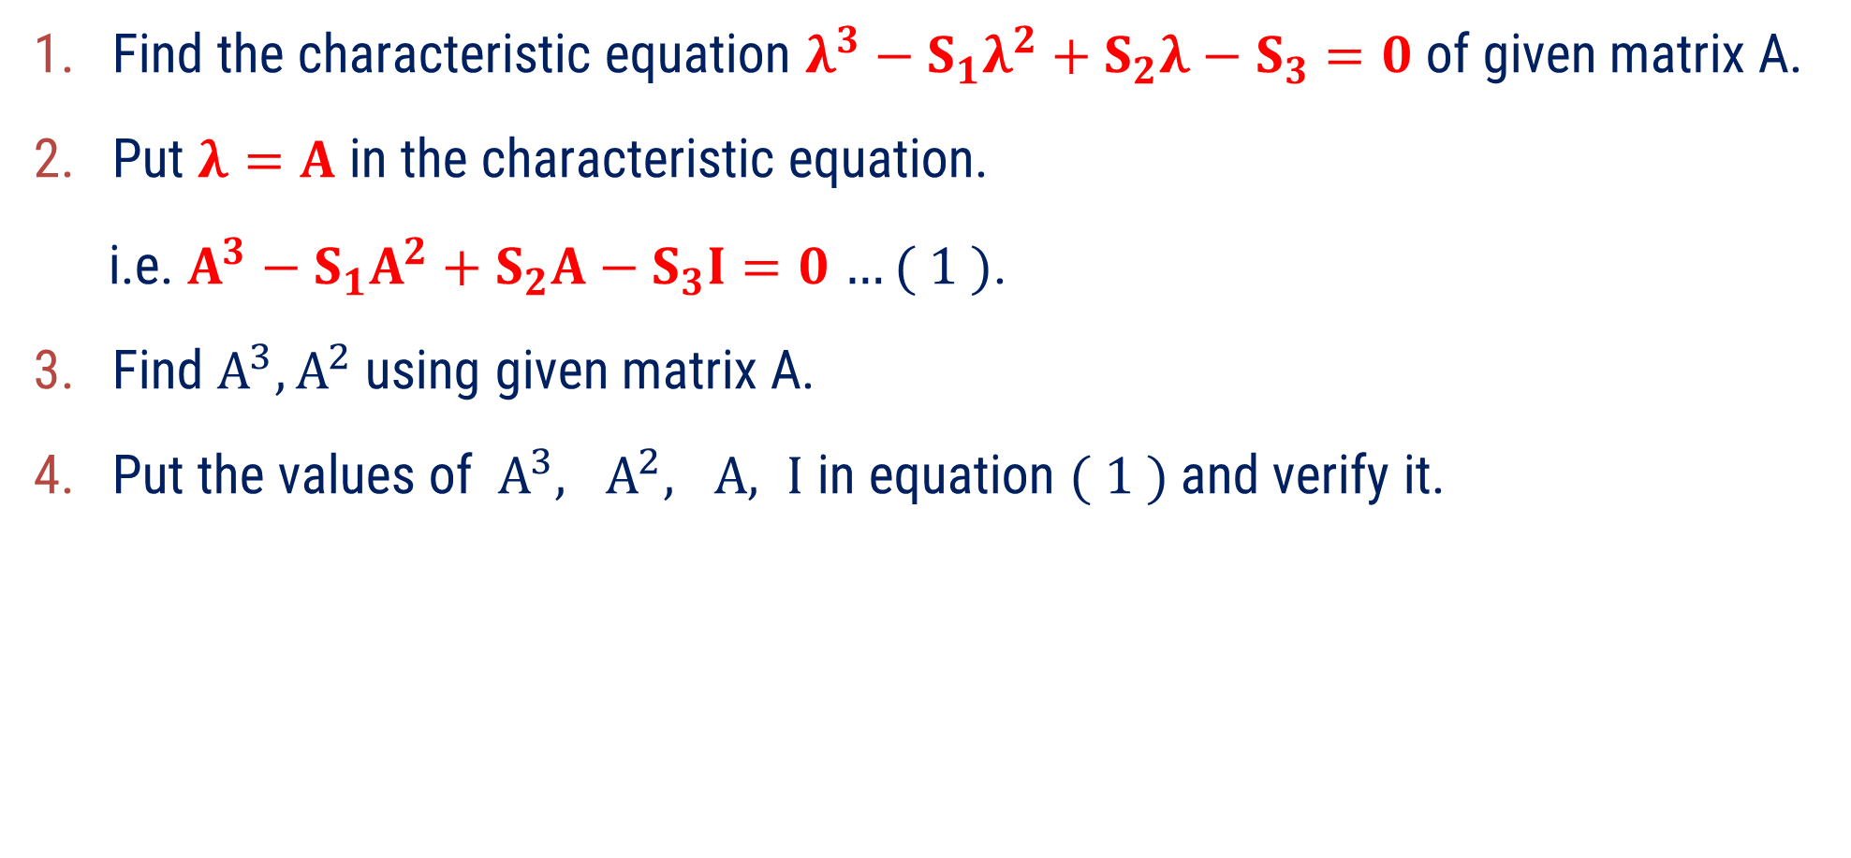
Procedure to verify Cayley-Hamilton Theorem for $3×3$ matrix
Find the characteristic equation $λ^{3}−S_{1}λ^{2}+S_{2}λ−S_{3}=0$of given matrix A.
Put $λ=A$ in the characteristic equation.
i.e. $A^{3}−S_{1}A^{2}+S_{2}A−S_{3}I=0$ $…( 1 )$.
Find $A^{3}, A^{2}$ using given matrix A.
Put the values of $A^{3}, A^{2}, A, I$ in equation $( 1 )$ and verify it.
The procedure remains same for any matrix of order $n$.

Slide 32
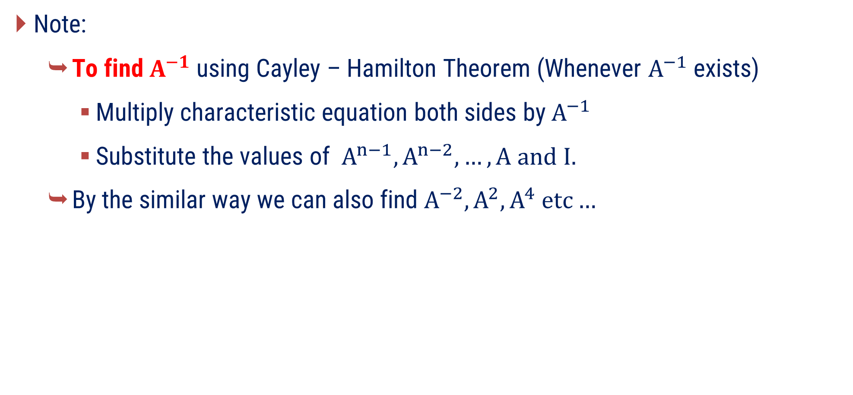
Cayley – Hamilton Theorem
Note:
  To find $A^{−1}$ using Cayley – Hamilton Theorem (Whenever $A^{−1}$ exists)
    Multiply characteristic equation both sides by $A^{−1}$
    Substitute the values of $A^{n−1},A^{n−2},…,A and I.$
  By the similar way we can also find $A^{−2},A^{2}, A^{4} etc…$

Slide 33










Method:2$⇝$Example:1
Example
Verify Cayley-Hamilton Theorem and use it to find inverse for
$A=\left[ \begin{matrix} 2 & −1 & 1 \\ −1 & 2 & −1 \\ 1 & −1 & 2\end{matrix} \right]$.
Solution
The characteristic equation of the matrix $A$ is given by
$$λ^{3}$$
$$− S_{1}λ^{2}$$
$$+ S_{2}λ$$
$$− S_{3}$$
$$=0$$
$$\left( 1 \right)$$
$S_{1}=$ Trace($A$)
$$=2+2+2$$
$$=6$$
$S_{2}=$ Sum of minors of principal diagonal elements
$$\left| \begin{matrix} 2 & −1 \\ −1 & 2\end{matrix} \right|$$
$$\left| \begin{matrix}2 & 1 \\ 1 & 2\end{matrix} \right|$$
$$\left| \begin{matrix} 2 & −1 \\ −1 & 2\end{matrix} \right|$$
$${⇒S}_{2} =$$
$$+$$
$$+$$
$$=3+3+3$$
$$=9$$

Slide 34










Method:2$⇝$Example:1(Continue)
$$A=\left[ \begin{matrix} 2 & −1 & 1 \\ −1 & 2 & −1 \\ 1 & −1 & 2\end{matrix} \right]$$
$${ S}_{3} =\left| A \right|$$
$$=2\left(3\right)+1\left(−1\right)+1\left(−1\right)$$
$$=4$$
From equation $\left(1\right)$, $λ^{3}−S_{1}λ^{2}+S_{2}λ−S_{3}=0$
$$S_{1}=6 ; S_{2}=9$$
$$⇒λ^{3}−6 λ^{2}+9 λ−4=0$$
$$\left( 2 \right)$$
By Cayley Hamilton’s Theorem, $A^{3}−6A^{2}+9A−4I=0$.
To verify above equation, we find $A^{3}$ and $A^{2}$.
$$=\left[ \begin{matrix} 2 & −1 & 1 \\ −1 & 2 & −1 \\ 1 & −1 & 2\end{matrix} \right]∙\left[ \begin{matrix} 2 & −1 & 1 \\ −1 & 2 & −1 \\ 1 & −1 & 2\end{matrix} \right]$$
$$=\left[ \begin{matrix} 6 & −5 & 5 \\ −5 & 6 & −5 \\ 5 & −5 & 6\end{matrix} \right]$$
$$A^{2}=A∙A$$

Slide 35





Method:2$⇝$Example:1(Continue)
$$A=\left[ \begin{matrix} 2 & −1 & 1 \\ −1 & 2 & −1 \\ 1 & −1 & 2\end{matrix} \right]$$
$$A^{3}=A^{2}∙A$$
$$=\left[ \begin{matrix} 6 & −5 & 5 \\ −5 & 6 & −5 \\ 5 & −5 & 6\end{matrix} \right]∙\left[ \begin{matrix} 2 & −1 & 1 \\ −1 & 2 & −1 \\ 1 & −1 & 2\end{matrix} \right]$$
$$A^{2}=\left[ \begin{matrix} 6 & −5 & 5 \\ −5 & 6 & −5 \\ 5 & −5 & 6\end{matrix} \right]$$
$$=\left[ \begin{matrix} 22 & −21 & 21 \\ −21 & 22 & −21 \\ 21 & −21 & 22\end{matrix} \right]$$

Slide 36










Method:2$⇝$Example:1(Continue)
Now, $A^{3}−6 A^{2}+9 A−4 I$
$$=\left[ \begin{matrix} 22 & −21 & 21 \\ −21 & 22 & −21 \\ 21 & −21 & 22\end{matrix} \right]$$
$$− 6\left[ \begin{matrix} 6 & −5 & 5 \\ −5 & 6 & −5 \\ 5 & −5 & 6\end{matrix} \right]$$
$$+ 9\left[ \begin{matrix} 2 & −1 & 1 \\ −1 & 2 & −1 \\ 1 & −1 & 2\end{matrix} \right]$$
$$− 4\left[ \begin{matrix}1 & 0 & 0 \\ 0 & 1 & 0 \\ 0 & 0 & 1\end{matrix} \right]$$
$$=\left[ \begin{matrix}22−36+18−4 & −21+30−9−0 & 21−30+9−0 \\ −21+30−9−0 & 22−36+18−4 & −21+30−9−0 \\ 21−30+9−0 & −21+30−9−0 & 22−36+18−4\end{matrix} \right]$$
$$=\left[ \begin{matrix}0 & 0 & 0 \\ 0 & 0 & 0 \\ 0 & 0 & 0\end{matrix} \right]=O$$
$$A=\left[ \begin{matrix} 2 & −1 & 1 \\ −1 & 2 & −1 \\ 1 & −1 & 2\end{matrix} \right]$$
$$A^{2}=\left[ \begin{matrix} 6 & −5 & 5 \\ −5 & 6 & −5 \\ 5 & −5 & 6\end{matrix} \right]$$
$$A^{3}=\left[ \begin{matrix} 22 & −21 & 21 \\ −21 & 22 & −21 \\ 21 & −21 & 22\end{matrix} \right]$$
Hence, Cayley-Hamilton Theorem is verified.

Slide 37





Method:2$⇝$Example:1(Continue)
Now, We have $A^{3}−6 A^{2}+9 A−4 I=O$
Since, $\left| A \right|≠0$. $A^{−1}$exists.
Multiplying above equation by $A^{−1}$,
$$A^{−1}A^{3}−6A^{−1}A^{2}+9A^{−1}A−4A^{−1}I=A^{−1}O$$
$$⇒A^{2}−6A+9I−4A^{−1}=O$$
$$⇒4A^{−1}=A^{2}−6A+9I$$

Slide 38







Method:2$⇝$Example:1(Continue)
$$A=\left[ \begin{matrix} 2 & −1 & 1 \\ −1 & 2 & −1 \\ 1 & −1 & 2\end{matrix} \right]$$
$$A^{2}=\left[ \begin{matrix} 6 & −5 & 5 \\ −5 & 6 & −5 \\ 5 & −5 & 6\end{matrix} \right]$$
$$⇒4A^{−1}=A^{2}−6A+9I$$
$$⇒4A^{−1}=\left[ \begin{matrix} 6 & −5 & 5 \\ −5 & 6 & −5 \\ 5 & −5 & 6\end{matrix} \right]$$
$− 6\left[ \begin{matrix} 2 & −1 & 1 \\ −1 & 2 & −1 \\ 1 & −1 & 2\end{matrix} \right]$
$$+ 9 \left[ \begin{matrix}1 & 0 & 0 \\ 0 & 1 & 0 \\ 0 & 0 & 1\end{matrix} \right]$$
$$=\left[ \begin{matrix} 3 & 1 & −1 \\ 1 & 3 & 1 \\ −1 & 1 & 3\end{matrix} \right]$$
$$⇒4A^{−1}$$
$$⇒A^{−1}=\frac{1}{ 4 }\left[ \begin{matrix} 3 & 1 & −1 \\ 1 & 3 & 1 \\ −1 & 1 & 3\end{matrix} \right]$$

Slide 39



















Method:2$⇝$Example:2
By using Cayley-Hamilton theorem for matrix $A=\left[ \begin{matrix} 1 & 3 & 2 \\ 0 & −1 & 4 \\ −2 & 1 & 5\end{matrix} \right]$,
find matrix represented by
$$A^{8}−5A^{7}−A^{6}+37A^{5}+A^{4}−5A^{3}−3A^{2}+41A+3I.$$
Example
Solution
The characteristic equation of the matrix $A$ is given by
$$λ^{3}$$
$$− S_{1}λ^{2}$$
$$+ S_{2}λ$$
$$− S_{3}$$
$$=0$$
$$\left( 1 \right)$$
$S_{1}=$ Trace(A)
$$=1−1+5$$
$$=5$$
$S_{2}=$ Sum of minors of principal diagonal elements
$$\left| \begin{matrix}−1 & 4 \\ 1 & 5\end{matrix} \right|$$
$$\left| \begin{matrix} 1 & 2 \\ −2 & 5\end{matrix} \right|$$
$$\left| \begin{matrix}1 & 3 \\ 0 & −1\end{matrix} \right|$$
$${⇒S}_{2} =$$
$$+$$
$$+$$
$$=−9+9−1$$
$$=−1$$

Slide 40
















Method:2$⇝$Example:2(Continue)
$$A=\left[ \begin{matrix} 1 & 3 & 2 \\ 0 & −1 & 4 \\ −2 & 1 & 5\end{matrix} \right]$$
$${ S}_{3} =\left| A \right|$$
$$=1\left(−9\right)−3\left(8\right)+2\left(−2\right)$$
$$=−37$$
From equation $\left(1\right)$, $λ^{3}−S_{1}λ^{2}+S_{2}λ−S_{3}=0$
$$S_{1}=5 ; S_{2}=−1$$
$$⇒λ^{3}−5 λ^{2}− λ+37=0$$
$$\left( 2 \right)$$
By Cayley Hamilton’s Theorem, $A^{3}−5A^{2}−A+37I=0$.
Let us find, $A^{8}−5A^{7}−A^{6}+37A^{5}+A^{4}−5A^{3}−3A^{2}+41A+3 I$
$$= A^{5} \left(A^{3}−5A^{2}−A+37 I\right)$$
$$− A$$
$$+ 37 I$$
$$− 2A^{2}$$
$$+ 4A$$
$$+ 3I$$
$$+ A \left(A^{3}−5A^{2}− A+37 I\right)$$
$$= A^{5} \left( O \right) + A\left( O \right)$$
$$− 2A^{2}+4A+3I$$
$$\left( 3 \right)$$

Slide 41




Method:2$⇝$Example:2(Continue)
$$A=\left[ \begin{matrix} 1 & 3 & 2 \\ 0 & −1 & 4 \\ −2 & 1 & 5\end{matrix} \right]$$
$$=− 2A^{2}+4A+3I$$
$$=− 2\left[ \begin{matrix} 1 & 3 & 2 \\ 0 & −1 & 4 \\ −2 & 1 & 5\end{matrix} \right]\left[ \begin{matrix} 1 & 3 & 2 \\ 0 & −1 & 4 \\ −2 & 1 & 5\end{matrix} \right]$$
$$+ 4\left[ \begin{matrix} 1 & 3 & 2 \\ 0 & −1 & 4 \\ −2 & 1 & 5\end{matrix} \right]+3\left[ \begin{matrix}1 & 0 & 0 \\ 0 & 1 & 0 \\ 0 & 0 & 1\end{matrix} \right]$$
$$=− 2\left[ \begin{matrix}−3 & 2 & 24 \\ −8 & 5 & 16 \\ −12 & −2 & 25\end{matrix} \right]+\left[ \begin{matrix}4 & 12 & 8 \\ 0 & −4 & 16 \\ −8 & 4 & 20\end{matrix} \right]+\left[ \begin{matrix}3 & 0 & 0 \\ 0 & 3 & 0 \\ 0 & 0 & 3\end{matrix} \right]$$

Slide 42



Method:2$⇝$Example:2(Continue)
$$=− 2\left[ \begin{matrix}−3 & 2 & 24 \\ −8 & 5 & 16 \\ −12 & −2 & 25\end{matrix} \right]+\left[ \begin{matrix}4 & 12 & 8 \\ 0 & −4 & 16 \\ −8 & 4 & 20\end{matrix} \right]+\left[ \begin{matrix}3 & 0 & 0 \\ 0 & 3 & 0 \\ 0 & 0 & 3\end{matrix} \right]$$
$$=\left[ \begin{matrix}13 & 8 & −40 \\ 16 & −11 & −16 \\ 16 & 8 & −27\end{matrix} \right]$$
Hence,
$$A^{8}−5A^{7}−A^{6}+37A^{5}+A^{4}−5A^{3}−3A^{2}+41A+3I=\left[ \begin{matrix}13 & 8 & −40 \\ 16 & −11 & −16 \\ 16 & 8 & −27\end{matrix} \right]$$

Slide 43
Method-3
Algebraic Multiplicity and Geometric Multiplicity

Slide 44


Algebraic Multiplicity (AM)
The algebraic multiplicity of an eigenvalue is the number of times it appears as a root of the characteristic polynomial of a matrix.
For Example:
  Matrix $A=\left[ \begin{matrix}1 & 1 & 1 \\ 1 & 1 & 1 \\ 1 & 1 & 1\end{matrix} \right]$ has eigenvalues $0, 0, 3$.
  AM of $λ_{1}=λ_{2}=0$ is $2$ (as it repeats twice)
  AM of $λ_{3}=3$ is $1$ (as it repeats once)

Slide 45


Geometric Multiplicity (GM)
Geometric multiplicity of an eigenvalue is the dimension of the eigenspace (free variables) associated with an eigenvalue.
OR
Geometric multiplicity of an eigenvalue $λ$ of the matrix A is nullity of $A−λI$
i.e. $η\left(A−λI\right)$.
Remark:
  $1≤GM≤AM$.
  i.e. If AM of $λ=1$, then GM of $λ=1$.
There are two different ways, to find GM of eigenvalue.
  By using, Dimension of the eigenspace (free variables).
  By using, Nullity of $A−λI$. i.e. $η\left(A−λI\right)$.

Slide 46

Geometric Multiplicity (GM)
For Example: Matrix $A=\left[ \begin{matrix}1 & 1 & 1 \\ 1 & 1 & 1 \\ 1 & 1 & 1\end{matrix} \right]$ has eigenvalues $0, 0, 3$.
  Eigenspace corresponding to $0$ is $E_{λ_{1}=0}=\left\{ \left[\begin{matrix}−1 \\ 1 \\ 0\end{matrix}\right]∙s+\left[\begin{matrix}−1 \\ 0 \\ 1\end{matrix}\right]∙t | s, t∈ℝ \right\}$
  Here, there are $2$ LI vectors to represent $E_{λ_{1}=0}.$
  i.e. Dimension of $E_{λ_{1}=0}=2$.
  i.e. GM of eigenvalue$λ_{1}=0 is 2$.

Slide 47

Geometric Multiplicity (GM)
For Example: Matrix $A=\left[ \begin{matrix}1 & 1 & 1 \\ 1 & 1 & 1 \\ 1 & 1 & 1\end{matrix} \right]$ has eigenvalues $0, 0, 3$.
  Eigenspace corresponding to $3$ is $E_{λ_{3}=3}=\left\{ \left[ \begin{matrix}1 \\ 1 \\ 1\end{matrix} \right]∙t | t∈ℝ \right\}$
  Here, there are $1$ LI vectors to represent $E_{λ_{3}=3}.$
  i.e. Dimension of $E_{λ_{3}=3}=1$.
  i.e. GM of eigenvalue$λ_{3}=3 is 1$.
Since, AM of $λ_{3}=3$ is $1$. By property, GM of $λ_{3}=3$ is $1$.

Slide 48








Geometric Multiplicity (GM)
For Example: Matrix $A=\left[ \begin{matrix}1 & 1 & 1 \\ 1 & 1 & 1 \\ 1 & 1 & 1\end{matrix} \right]$ has eigenvalues $0, 0, 3$.
For $λ_{1}=λ_{2}=0$
  Now, $A−λ_{1}I =A−0I$ $=A=\left[ \begin{matrix}1 & 1 & 1 \\ 1 & 1 & 1 \\ 1 & 1 & 1\end{matrix} \right]\sim \left[ \begin{matrix}1 & 1 & 1 \\ 0 & 0 & 0 \\ 0 & 0 & 0\end{matrix} \right]$
$$=\left[ \begin{matrix}1 & 1 & 1 \\ 1 & 1 & 1 \\ 1 & 1 & 1\end{matrix} \right]$$
$\sim \left[ \begin{matrix}1 & 1 & 1 \\ 0 & 0 & 0 \\ 0 & 0 & 0\end{matrix} \right]$
$A−0I$ $=A$
  Now, $η\left(A−0I\right)=$ No. of column$− ρ\left(A−0I\right)$
  $$=3−1$$
  $$=2$$
  So, GM of eigenvalue$λ_{1}=λ_{2}=0 is 2$.

Slide 49








Geometric Multiplicity (GM)
For Example: Matrix $A=\left[ \begin{matrix}1 & 1 & 1 \\ 1 & 1 & 1 \\ 1 & 1 & 1\end{matrix} \right]$ has eigenvalues $0, 0, 3$.
  For $λ_{3}=3$
  Now, $A−λ_{3}I =A−0I$ $=\left[ \begin{matrix}1 & 1 & 1 \\ 1 & 1 & 1 \\ 1 & 1 & 1\end{matrix} \right]\sim \left[ \begin{matrix}1 & 1 & 1 \\ 0 & 0 & 0 \\ 0 & 0 & 0\end{matrix} \right]$
$$=\left[\begin{matrix}−2 & 1 & 1 \\ 1 & −2 & 1 \\ 1 & 1 & −2\end{matrix} \right]$$
$$\sim \left[ \begin{matrix}1 & −2 & 1 \\ 0 & 1 & −1 \\ 0 & 0 & 0\end{matrix} \right]$$
$$A−3I$$
  Now, $η\left(A−3I\right)=$ No. of column$− ρ\left(A−3I\right)$
  $$=3−2$$
  $$=1$$
  So, GM of eigenvalue $λ_{3}=3 is 1$.
Since, AM of $λ_{3}=3$ is $1$. By property, GM of $λ_{3}=3$ is $1$.

Slide 50




Method:3$⇝$Example:1
Example
Find AM and GM for each of the eigenvalue of matrix
$A=\left[ \begin{matrix}1 & 2 & 3 \\ 0 & 2 & 2 \\ 0 & 0 & 2\end{matrix} \right]$.
Solution
The given matrix is an upper triangular matrix.
So, the eigenvalues of $A$are $1, 2, 2$.
Hence, AM of $λ_{1}=1$ (appears once)
and $λ_{2}=λ_{3}=2$ (appears twice).
Now, Let’s find $η\left(A−λI\right)$ to find GM of each eigenvalue.
Note that, $η\left(A−λI\right)=$ No. of column $− ρ\left(A−λI\right)$

Slide 51











Method:3$⇝$Example:1(Continue)
For eigenvalue $λ_{1}=1$
$$A=\left[ \begin{matrix}1 & 2 & 3 \\ 0 & 2 & 2 \\ 0 & 0 & 2\end{matrix} \right]$$
Since, AM of $λ_{1}=1$
So, GM of $λ_{1}=1$
$\left( ∵1≤GM≤AM \right)$
For eigenvalue $λ_{2}=2$
Since, AM of $λ_{2}=2$
$$=\left[ \begin{matrix}−1 & 2 & 3 \\ 0 & 0 & 2 \\ 0 & 0 & 0\end{matrix} \right]$$
$$A−λI=$$
$$A−2I$$
Now, $η\left(A−λI\right)=$ No. of column$− ρ\left(A−λI\right)$
$$=3−2=1$$
So, GM of $λ_{2}=1$

Slide 52



















Method:3$⇝$Example:2
Find $η\left(A−λI\right)$ for each $λ$ of $A=\left[ \begin{matrix} 4 & 0 & 1 \\ −2 & 1 & 0 \\ −2 & 0 & 1\end{matrix} \right]$.
Example
Solution
The characteristic equation of the matrix $A$ is given by
$$λ^{3}$$
$$− S_{1}λ^{2}$$
$$+ S_{2}λ$$
$$− S_{3}$$
$$=0$$
$$\left( 1 \right)$$
$S_{1}=$ Trace($A$)
$$=4+1+1$$
$$=6$$
$S_{2}=$ Sum of minors of principal diagonal elements
$$\left| \begin{matrix}1 & 0 \\ 0 & 1\end{matrix} \right|$$
$$\left| \begin{matrix} 4 & 1 \\ −2 & 1\end{matrix} \right|$$
$$\left| \begin{matrix} 4 & 0 \\ −2 & 1\end{matrix} \right|$$
$${⇒S}_{2} =$$
$$+$$
$$+$$
$$=1+6+4$$
$$=11$$

Slide 53








Method:3$⇝$Example:2(Continue)
$$A=\left[ \begin{matrix} 4 & 0 & 1 \\ −2 & 1 & 0 \\ −2 & 0 & 1\end{matrix} \right]$$
$${ S}_{3} =\left| A \right|$$
$$=4\left(1\right)+0+1\left(2\right)$$
$$=6$$
From equation $\left(1\right)$, $λ^{3}−S_{1}λ^{2}+S_{2}λ−S_{3}=0$
$$S_{1}=6 ; S_{2}=11$$
$$⇒λ^{3}−6 λ^{2}+11 λ−6=0$$
Try
$$λ =1 ; 2 ; 3$$
$$⇒\left(λ−1\right)\left(λ^{2}−5λ+6\right)=0$$
$$⇒\left(λ−1\right)\left(λ−2\right)\left(λ−3\right)=0$$

Slide 54



Method:3$⇝$Example:2(Continue)
$$λ=1, 2, 3$$
Since, All eigenvalues are distinct.
So, AM $=$ GM $=1$ for all eigenvalues.
Hence by the definition of GM, $η\left(A−λI\right)=1$ for all eigenvalues.
Geometric multiplicity of an eigenvalue $λ$ of the matrix A is nullity of $A−λI$.
i.e. $η\left(A−λI\right)$.

Slide 55







Method:3$⇝$Example:3
Example
Let $A_{5×5}$ be a matrix with $\left| A \right|=720, tr\left(A\right)=15$ and the eigenvalues of the matrix A are $2, 3, 5, α$ and $β$ then find the possible values of $η\left(A−5I\right)$.
Solution
Also, $\left| A \right|=720$
$$⇒2×3×5×α×β=720$$
$$⇒αβ=24$$
Here, $tr\left(A\right)=15$
$$⇒2+3+5+α+β=15$$
$$⇒α+β=5$$

Slide 56








Method:3$⇝$Example:3(Continue)
$$αβ=24$$
$$α+β=5$$
Now, $αβ=24$
$$⇒α\left(5−α\right)=24$$
$$aα^{2}+bα+c=0$$
$$α=\frac{−b±\sqrt{ b^{2}−4ac }}{2a}$$
$$⇒5α−α^{2}=24$$
$$⇒α^{2}−5α+24=0$$
$$⇒α=\frac{ 5±\sqrt{ 25−96 } }{2}$$
$$⇒α=\frac{ 5±\sqrt{71 } i }{2}$$

Slide 57







Method:3$⇝$Example:3(Continue)
$$⇒α=\frac{ 5±\sqrt{71 }i }{2}$$
$$αβ=24$$
$$α+β=5$$
$$≠ 5$$
Clearly, $β≠ 5$.
So, AM of $λ=5$ is $1$.
Hence$\text{, }\text{G}\text{M} \text{of} λ=5 \text{is} 1\text{. }$
i.e. $η\left(A−5I\right)=1$
Geometric multiplicity of an eigenvalue $λ$ of the matrix A is nullity of $A−λI$.
i.e. $η\left(A−λI\right)$.

Slide 58
Method-4
Diagonalization of Matrices

Slide 59

Matrix Diagonalization
A square matrix $A$ is Diagonalizable if it is similar to diagonal matrix $D$.
OR
A square matrix $A$ is Diagonalizable if there exist an invertible matrix $P$ and diagonal matrix D such that $D=P^{−1} A P$.
Note:
  $\text{T}\text{he} \text{invertible} \text{matrix} P \text{is} \text{known} \text{as} \text{D}\text{iagonalizing} \text{M}\text{atrix}\text{ / }\text{Modal} \text{Matrix}$.
  A diagonal matrix $D$ is known as a Spectral Matrix.
  A square matrix $A$ is Orthogonally Diagonalizable if there exist an Orthogonal Matrix $P′$ and diagonal matrix $D$ such that $D=P^{′−1} A P′$.

Slide 60

Properties
If all the eigenvalues of a square matrix $A$ are distinct, then a matrix $A$ is always diagonalizable.
A square matrix $A$ of order $n$ is diagonalizable if and only if it possesses $n$ linearly independent eigenvectors.
A square matrix $A$ is diagonalizable if and only if the AM is equal to the GM for each eigenvalue.
Every real symmetric matrix is always diagonalizable as well as orthogonally diagonalizable.

Slide 61

Properties
For real skew-symmetric matrix $A$, $A^{2n}$is always diagonalizable.
An Idempotent and Involutory matrices are always diagonalizable.

Slide 62

Procedure to find a Diagonalizing Matrix / Modal Matrix $\left(P\right)$
Let $A$ be any square matrix of order $n$.
Find the eigenvalues $\left(λ_{1} ,λ_{2} ,…,λ_{n} \right)$ of matrix $A$.
Find eigenvectors corresponding to each eigenvalue of the matrix $A$.
Construct the diagonalizing matrix $(P)$ by placing all the eigenvectors into the columns of the matrix.
Note:
  If $P^{−1}$ exist, then the diagonal matrix $D=diag[λ_{1} ,λ_{2} ,…,λ_{n}]$.

Slide 63

Procedure to find a Diagonal Matrix / Spectral Matrix$\left(D\right)$
Let $A$ be any square matrix of order $n$.
Find the eigenvalues $\left(λ_{1} ,λ_{2} ,…,λ_{n} \right)$ of matrix $A$.
Find AM & GM for each eigenvalue of the matrix $A$.
If AM & GM for each eigenvalue is equal, then diagonal matrix
$$D=diag[ λ_{1} , λ_{2} ,…,λ_{n} ]$$

Slide 64



















Method:4$⇝$Example:1
Example
Find diagonalizing matrix and diagonal matrix for a given matrix $A=\left[ \begin{matrix}0 & 1 & 1 \\ 1 & 0 & 1 \\ 1 & 1 & 0\end{matrix} \right]$
Solution
The characteristic equation of the matrix $A$ is given by
$$λ^{3}$$
$$− S_{1}λ^{2}$$
$$+ S_{2}λ$$
$$− S_{3}$$
$$=0$$
$$\left( 1 \right)$$
$S_{1}=$ Trace($A$)
$$=0+0+0$$
$$=0$$
$S_{2}=$ Sum of minors of principal diagonal elements
$$\left| \begin{matrix}0 & 1 \\ 1 & 0\end{matrix} \right|$$
$$\left| \begin{matrix}0 & 1 \\ 1 & 0\end{matrix} \right|$$
$$\left| \begin{matrix}0 & 1 \\ 1 & 0\end{matrix} \right|$$
$${⇒S}_{2} =$$
$$+$$
$$+$$
$$=−1−1−1$$
$$=−3$$

Slide 65









Method:4$⇝$Example:1(Continue)
$$A=\left[ \begin{matrix}0 & 1 & 1 \\ 1 & 0 & 1 \\ 1 & 1 & 0\end{matrix} \right]$$
$${ S}_{3} =\left| A \right|$$
$$=0−1\left(−1\right)+1\left(1\right)$$
$$=2$$
From equation $\left(1\right)$, $λ^{3}− S_{1}λ^{2}+ S_{2}λ− S_{3}=0$
$$S_{1}=0 ; S_{2}=−3$$
$$⇒λ^{3}−3 λ−2=0$$
$$⇒\left( λ+1 \right)\left( λ^{2}−λ−2 \right)=0$$
$$⇒\left( λ+1 \right)\left( λ^{2}−4λ+4 \right)=0$$
$$\left( λ+1 \right)\left( λ−2 \right)=0$$
$$⇒λ=−1, −1, 2$$

Slide 66




Method:4$⇝$Example:1(Continue)
To find eigenvector, consider the homogeneous system $\left(A−λI\right)X=O$.
$$\left[ \begin{matrix}0 & 1 & 1 \\ 1 & 0 & 1 \\ 1 & 1 & 0\end{matrix} \right]$$
$$− λ \left[ \begin{matrix}1 & 0 & 0 \\ 0 & 1 & 0 \\ 0 & 0 & 1\end{matrix} \right]$$
$$=\left[ \begin{matrix}− λ & 1 & 1 \\ 1 & − λ & 1 \\ 1 & 1 & − λ\end{matrix} \right]$$
Here, matrix $A−λI=$
To get eigenvector for $λ=−1$. We solve the system $\left(A+I\right)X=O$.
$$= \left[ \begin{matrix}1 & 1 & \begin{matrix}1 & 0\end{matrix} \\ 1 & 1 & \begin{matrix}1 & 0\end{matrix} \\ 1 & 1 & \begin{matrix}1 & 0\end{matrix}\end{matrix} \right]$$
Consider, The Augmented Matrix, $\left[ A+I | O \right]$

Slide 67










Method:4$⇝$Example:1(Continue)
Consider, the Augmented Matrix,
$$x+y+z=0$$
$$\left[ A+I | O \right]=\left[ \begin{matrix}1 & 1 & \begin{matrix}1 & 0\end{matrix} \\ 1 & 1 & \begin{matrix}1 & 0\end{matrix} \\ 1 & 1 & \begin{matrix}1 & 0\end{matrix}\end{matrix} \right]$$
$$⇒x=− t_{1}−t_{2}$$
$$X=\left[ \begin{matrix}\begin{aligned}x \\ \end{aligned} \\ \begin{aligned}y \\ \end{aligned} \\ z\end{matrix} \right]$$
$$=\left[ \begin{matrix}\begin{aligned}− t_{1}−t_{2} \\ \end{aligned} \\ \begin{aligned}t_{1} \\ \end{aligned} \\ t_{2}\end{matrix} \right]$$
Now,
$$R_{12}\left(−1\right),$$
$$R_{13}\left(−1\right)$$
$$\sim \left[ \begin{matrix}1 & 1 & \begin{matrix}1 & 0\end{matrix} \\ 0 & 0 & \begin{matrix}0 & 0\end{matrix} \\ 0 & 0 & \begin{matrix}0 & 0\end{matrix}\end{matrix} \right]$$
$$\sim \left[ \begin{matrix}1 & 1 & \begin{matrix}1 & 0\end{matrix} \\ 0 & 0 & \begin{matrix}0 & 0\end{matrix} \\ 1 & 1 & \begin{matrix}1 & 0\end{matrix}\end{matrix} \right]$$
Let, $y=t_{1} ,z=t_{2} ; t_{1},t_{2}∈ ℝ$

Slide 68






Method:4$⇝$Example:1(Continue)
$$=\left[ \begin{matrix}\begin{aligned}− t_{1}−t_{2} \\ \end{aligned} \\ \begin{aligned}t_{1} \\ \end{aligned} \\ t_{2}\end{matrix} \right]$$
$$P=\left[ \begin{matrix}−1 & −1 & \\ 1 & 0 & \\ 0 & 1 & \end{matrix} \right]$$
$$X=\left[ \begin{matrix}\begin{aligned}x \\ \end{aligned} \\ \begin{aligned}y \\ \end{aligned} \\ z\end{matrix} \right]$$
Now,
$$=t_{1}⋅\left[ \begin{matrix}\begin{aligned}−1 \\ \end{aligned} \\ \begin{aligned} 1 \\ \end{aligned} \\ 0\end{matrix} \right]$$
$$+ t_{2}⋅\left[ \begin{matrix}\begin{aligned}−1 \\ \end{aligned} \\ \begin{aligned} 0 \\ \end{aligned} \\ 1\end{matrix} \right]$$
$$; t_{1},t_{2}∈ ℝ$$

Slide 69







Method:4$⇝$Example:1(Continue)
To get eigenvector for $λ=2$,
We solve the system $\left(A−2I\right)X=O$.
$$P=\left[ \begin{matrix}−1 & −1 & \\ 1 & 0 & \\ 0 & 1 & \end{matrix} \right]$$
Consider, The Augmented Matrix,
$$A=\left[ \begin{matrix}0 & 1 & 1 \\ 1 & 0 & 1 \\ 1 & 1 & 0\end{matrix} \right]$$
$$\left[ A−2I | O \right]=\left[ \begin{matrix}−2 & 1 & \begin{matrix} 1 & 0\end{matrix} \\ 1 & −2 & \begin{matrix} 1 & 0\end{matrix} \\ 1 & 1 & \begin{matrix}−2 & 0\end{matrix}\end{matrix} \right]$$
$$\sim \left[ \begin{matrix}−2 & 1 & \begin{matrix} 1 & 0\end{matrix} \\ 0 & −\frac{3}{ 2 } & \begin{matrix} \frac{3}{ 2 } & 0\end{matrix} \\ 0 & \frac{3}{ 2 } & \begin{matrix}−\frac{3}{ 2 } & 0\end{matrix}\end{matrix} \right]$$
$$\sim \left[ \begin{matrix}−2 & 1 & \begin{matrix} 1 & 0\end{matrix} \\ 0 & −\frac{3}{ 2 } & \begin{matrix}\frac{3}{ 2 } & 0\end{matrix} \\ 0 & 0 & \begin{matrix} 0 & 0\end{matrix}\end{matrix} \right]$$
$$R_{12}\left(\frac{1}{ 2 }\right),$$
$$R_{13}\left(\frac{1}{ 2 }\right)$$

Slide 70




Method:4$⇝$Example:1(Continue)
$$\sim \left[ \begin{matrix}−2 & 1 & \begin{matrix} 1 & 0\end{matrix} \\ 0 & −\frac{3}{ 2 } & \begin{matrix} \frac{3}{ 2 } & 0\end{matrix} \\ 0 & \frac{3}{ 2 } & \begin{matrix}−\frac{3}{ 2 } & 0\end{matrix}\end{matrix} \right]$$
$$P=\left[ \begin{matrix}−1 & −1 & \\ 1 & 0 & \\ 0 & 1 & \end{matrix} \right]$$
$$A=\left[ \begin{matrix}0 & 1 & 1 \\ 1 & 0 & 1 \\ 1 & 1 & 0\end{matrix} \right]$$
$$R_{23}\left(1\right)$$
$$\sim \left[ \begin{matrix}−2 & 1 & \begin{matrix} 1 & 0\end{matrix} \\ 0 & −\frac{3}{ 2 } & \begin{matrix} \frac{3}{ 2 } & 0\end{matrix} \\ 0 & 0 & \begin{matrix} 0 & 0\end{matrix}\end{matrix} \right]$$
Let, $z=t_{3} ; t_{3}∈ ℝ$

Slide 71









Method:4$⇝$Example:1(Continue)
$$\sim \left[ \begin{matrix}−2 & 1 & \begin{matrix} 1 & 0\end{matrix} \\ 0 & −\frac{3}{ 2 } & \begin{matrix} \frac{3}{ 2 } & 0\end{matrix} \\ 0 & 0 & \begin{matrix} 0 & 0\end{matrix}\end{matrix} \right]$$
$$P=\left[ \begin{matrix}−1 & −1 & \\ 1 & 0 & \\ 0 & 1 & \end{matrix} \right]$$
Let, $z=t_{3} ; t_{3}∈ ℝ$
$$−\frac{ 3y }{2}+\frac{ 3z }{2}=0$$
$$−2x+y+z=0$$
$$⇒x=\frac{ y+z }{2}$$
$$⇒y=z$$
$$⇒y=t_{3}$$
$$⇒x=\frac{t_{3}+t_{3}}{2}$$
$$= t_{3}$$

Slide 72











Method:4$⇝$Example:1(Continue)
$$P=\left[ \begin{matrix}−1 & −1 & \\ 1 & 0 & \\ 0 & 1 & \end{matrix} \right]$$
$$= \left[ \begin{matrix}\begin{aligned} t_{3} \\ \end{aligned} \\ \begin{aligned}t_{3} \\ \end{aligned} \\ t_{3}\end{matrix} \right]$$
$$=t_{3}⋅\left[ \begin{matrix}\begin{aligned}1 \\ \end{aligned} \\ \begin{aligned}1 \\ \end{aligned} \\ 1\end{matrix} \right]$$
Since, $λ=−1, −1, 2$
$$P=\left[ \begin{matrix}−1 & −1 & 1 \\ 1 & 0 & 1 \\ 0 & 1 & 1\end{matrix} \right]$$
$$X=\left[ \begin{matrix}\begin{aligned}x \\ \end{aligned} \\ \begin{aligned}y \\ \end{aligned} \\ z\end{matrix} \right]$$
Hence, Diagonal Matrix
$D=\left[ \begin{matrix}−1 & 0 & 0 \\ 0 & −1 & 0 \\ 0 & 0 & 2\end{matrix} \right]$.
Now,
So, $P=\left[ \begin{matrix}−1 & −1 & 1 \\ 1 & 0 & 1 \\ 0 & 1 & 1\end{matrix} \right]$
$$\left| P \right|=$$
$$−1\left(−1\right)+1\left(1\right)+1\left(1\right)$$
$$=3$$
$$≠0$$
So, $P^{−1}$ exist.

Slide 73
















Method:4$⇝$Example:2
Show that the matrix $A=\left[ \begin{matrix}1 & −2 & 0 \\ 1 & 2 & 2 \\ 1 & 2 & 3\end{matrix} \right]$ is not diagonalizable.
Example
$$1$$
$$1 −6 9 −4$$
Here, $A=\left[ \begin{matrix}1 & −2 & 0 \\ 1 & 2 & 2 \\ 1 & 2 & 3\end{matrix} \right]$
Solution
$$0$$
$$1$$
$$−5$$
$$4$$
$$1$$
$$−5$$
$$4$$
$$0$$
The characteristic equation, $λ^{3}−S_{1}λ^{2}+S_{2}λ−S_{3}=0$
$⇒λ^{3}−6 λ^{2}+9λ−4=0$
$⇒\left( λ−1 \right)\left( λ^{2}−5λ+4\right)=0$
$⇒\left( λ−1 \right)\left( λ−1 \right)\left( λ−4 \right)=0$

Slide 74








Method:4$⇝$Example:2(Continue)
$⇒\left( λ−1 \right)\left( λ−1 \right)\left( λ−4 \right)=0$
$$⇒λ=1, 1, 4$$
Let us find AM and GM for both eigenvalues.
If AM and GM are same for all eigenvalues, the given matrix is diagonalizable.
For, $λ=4$
For, $λ=1$
AM$=1$ [ as repeats once ]
AM$=2$ [ as repeats twice ]
So, GM$=1$
For GM, we check $η\left(A−λI\right)=η\left(A−I\right)$

Slide 75













Method:4$⇝$Example:2(Continue)
$$=\left[ \begin{matrix}1 & −2 & 0 \\ 1 & 2 & 2 \\ 1 & 2 & 3\end{matrix} \right]−\left[ \begin{matrix}1 & 0 & 0 \\ 0 & 1 & 0 \\ 0 & 0 & 1\end{matrix} \right]$$
$$R_{13}\left(\frac{1}{ 2 }\right)$$
$$A=\left[ \begin{matrix}1 & −2 & 0 \\ 1 & 2 & 2 \\ 1 & 2 & 3\end{matrix} \right]$$
Now, $A−I$
$$=\left[ \begin{matrix}0 & −2 & 0 \\ 1 & 1 & 2 \\ 1 & 2 & 2\end{matrix} \right]$$
$$\sim \left[ \begin{matrix}0 & −2 & 0 \\ 1 & 1 & 2 \\ 0 & 0 & 0\end{matrix} \right]$$
$$R_{23}\left(−1\right)$$
Now, $η\left(A−I\right)$
$$\sim \left[ \begin{matrix}0 & −2 & 0 \\ 1 & 1 & 2 \\ 0 & 1 & 0\end{matrix} \right]$$
$=$No. of column $− ρ\left(A−I\right)$
$$=3$$
$$− 2$$
$$=1$$

Slide 76





Method:4$⇝$Example:2(Continue)
For, $λ=1$
AM$=2$ [ as repeats twice ]
GM$=η\left(A−λI\right)=η\left(A−I\right)$
$$=1$$
Here, AM and GM are different for $λ=1$.
Hence, A is not diagonalizable.

Slide 77
Method-5
Quadratic Forms and
Canonical Forms

Slide 78

Unit Vector
Let $x=\left(x_{1}, x_{2}, …, x_{n}\right)$ be any non-zero vector of $ℝ^{n}$. The length of vector $x$ is defined as $\sqrt{x_{1}^{2}+x_{2}^{2}+…+x_{n}^{2} }$.
Any non-zero vector $x=\left(x_{1}, x_{2}, …, x_{n}\right)$ in $ℝ^{n}$ can be made a Unit Vector by dividing its length. i.e.
$$x′=Unit Vector=\frac{\left(x_{1}, x_{2}, …, x_{n}\right)}{\sqrt{ x_{1}^{2}+x_{2}^{2}+…+x_{n}^{2} }}$$

Slide 79

Quadratic Forms
A quadratic form is a function $Q : ℝ^{n}→ ℝ$ defined as $Q\left(x\right)=x^{T} A x$, where $x$ is a vector from $ℝ^{n}$ and $A$ is an $n×n$ symmetric matrix.
  Here, the matrix $A$ is called the Matrix of Quadratic Form.

Slide 80

Matrix of Quadratic Form
The quadratic form corresponding to a symmetric matrix $A$ in $n$ variables $x_{1},x_{2},…, x_{n}$ can be written as
$$Q\left(x\right)=x^{T} A x=\sum_{i=1}^{n}{\sum_{j=1}^{n}{a_{ij}x_{i}x_{j}}} …(1)$$
Where, $a_{ij}=a_{ji}$for each$i$and$j$
$$A=\left[ \begin{matrix}a_{11} & a_{12} & … & a_{1n} \\ a_{12} & a_{22} & … & a_{2n} \\ … & … & … & … \\ a_{1n} & a_{2n} & … & a_{nn}\end{matrix} \right]$$

Slide 81

Matrix of Quadratic Form
From Definition,
  Coefficient of $x_{i}x_{j}=a_{ij}+a_{ji}=2 a_{ij}=2 a_{ji}$ $\left( ∵a_{ij}=a_{ji} ;i≠j \right)$
  Coefficient of $x_{i}^{2}=a_{ii}$
Remarks:
  The general Quadratic form for $2$ variables is given as,
    $Q\left(x_{1}, x_{2}\right)=a_{11} x_{1}^{2}+a_{22} x_{2}^{2}+2a_{12} x_{1}x_{2}$
  The general Quadratic form for $3$ variables is given as,
    $Q\left(x_{1}, x_{2},x_{3}\right)=a_{11} x_{1}^{2}+a_{22} x_{2}^{2}+a_{33} x_{3}^{2}+2a_{12} x_{1}x_{2}+2a_{13} x_{1}x_{3}+2a_{23} x_{2}x_{3}$

Slide 82

Method:5$⇝$Example:1
Example
Write down the Quadratic forms corresponding to the following matrices.
$$\left(i\right) A=\left[ \begin{matrix}2 & 1 & 5 \\ 1 & 3 & −2 \\ 5 & −2 & 4\end{matrix} \right] \left(ii\right) B=\left[ \begin{matrix}0 & 1 & 2 & 3 \\ 1 & 2 & 3 & 4 \\ 2 & 3 & 4 & 5 \\ 3 & 4 & 5 & 6\end{matrix} \right]$$

Slide 83













Method:5$⇝$Example:1(Continue)
Solution
$$A=\left[ \begin{matrix}2 & 1 & 5 \\ 1 & 3 & −2 \\ 5 & −2 & 4\end{matrix} \right]$$
The Quadratic form for matrix $A$ of order $3$ is,
$$a_{11} x_{1}^{2}+a_{22}x_{2}^{2}+a_{33}x_{3}^{2}+2a_{12}x_{1}x_{2}+2a_{13}x_{1}x_{3}+2a_{23}x_{2}x_{3}$$
Since, Coefficient of $x_{i}^{2}=a_{ii}$ ; Coefficient of $x_{i}x_{j}=a_{ij}+a_{ji}=2a_{ij}=2a_{ji}$
  Coefficient of $x_{1}^{2}=a_{11}$
  $$=2$$
  Coefficient of $x_{1}x_{2}=2a_{12}$
  $$=2\left(1\right)=2$$
  Coefficient of $x_{2}^{2}=a_{22}$
  $$=3$$
  Coefficient of $x_{1}x_{3}=2a_{13}$
  $$=2\left(5\right)=10$$
  Coefficient of $x_{3}^{2}=a_{33}$
  $$=4$$
  Coefficient of $x_{2}x_{3}=2a_{23}$
  $$=2\left(−2\right)=−4$$
Quadratic form: $2x_{1}^{2}+3x_{2}^{2}+4x_{3}^{2}+2x_{1}x_{2}+10x_{1}x_{3}−4x_{2}x_{3}$

Slide 84











Method:5$⇝$Example:1(Continue)
Solution
The Quadratic form for matrix $B$ of order $4$ is,
$$B=\left[ \begin{matrix}0 & 1 & 2 & 3 \\ 1 & 2 & 3 & 4 \\ 2 & 3 & 4 & 5 \\ 3 & 4 & 5 & 6\end{matrix} \right]$$
$$a_{11} x_{1}^{2}+a_{22} x_{2}^{2}+a_{33} x_{3}^{2}+a_{44} x_{4}^{2}+$$
$$2a_{12} x_{1}x_{2}+2a_{13} x_{1}x_{3}+2a_{14} x_{1}x_{4}+$$
$$2a_{23} x_{2}x_{3}+2a_{24} x_{2}x_{4}+2a_{34} x_{3}x_{4}$$
Since, Coefficient of $x_{i}^{2}=a_{ii}$ ; Coefficient of $x_{i}x_{j}=a_{ij}+a_{ji}=2a_{ij}=2a_{ji}$
  Coefficient of $x_{1}^{2}=a_{11}$
  $$=0$$
  Coefficient of $x_{3}^{2}=a_{33}$
  $$=4$$
  Coefficient of$x_{2}^{2}=a_{22}$
  $$=2$$
  Coefficient of $x_{4}^{2}=a_{44}$
  $$=6$$

Slide 85












Method:5$⇝$Example:1(Continue)
Solution
The Quadratic form for matrix $B$ of order $4$ is,
$$B=\left[ \begin{matrix}0 & 1 & 2 & 3 \\ 1 & 2 & 3 & 4 \\ 2 & 3 & 4 & 5 \\ 3 & 4 & 5 & 6\end{matrix} \right]$$
$$a_{11} x_{1}^{2}+a_{22} x_{2}^{2}+a_{33} x_{3}^{2}+a_{44} x_{4}^{2}+$$
$$2a_{12} x_{1}x_{2}+2a_{13} x_{1}x_{3}+2a_{14} x_{1}x_{4}+$$
$$2a_{23} x_{2}x_{3}+2a_{24} x_{2}x_{4}+2a_{34} x_{3}x_{4}$$
Since, Coefficient of $x_{i}^{2}=a_{ii}$ ; Coefficient of $x_{i}x_{j}=a_{ij}+a_{ji}=2a_{ij}=2a_{ji}$
  Coefficient of $x_{1}x_{2}=2a_{12}$
  $$=2\left(1\right)=2$$
  Coefficient of $x_{2}x_{3}=2a_{23}$
  $$=2\left(3\right)=6$$
  Coefficient of$x_{1}x_{3}=2a_{13}$
  $$=2\left(2\right)=4$$
  Coefficient of $x_{2}x_{4}=2a_{24}$
  $$=2\left(4\right)=8$$
  Coefficient of $x_{1}x_{4}=2a_{14}$
  $$=2\left(3\right)=6$$
  Coefficient of $x_{3}x_{4}=2a_{34}$
  $$=2\left(5\right)=10$$

Slide 86



Method:5$⇝$Example:1(Continue)
Solution
The Quadratic form for matrix $B$ of order $4$ is,
$$B=\left[ \begin{matrix}0 & 1 & 2 & 3 \\ 1 & 2 & 3 & 4 \\ 2 & 3 & 4 & 5 \\ 3 & 4 & 5 & 6\end{matrix} \right]$$
$$a_{11} x_{1}^{2}+a_{22} x_{2}^{2}+a_{33} x_{3}^{2}+a_{44} x_{4}^{2}+$$
$$2a_{12} x_{1}x_{2}+2a_{13} x_{1}x_{3}+2a_{14} x_{1}x_{4}+$$
$$2a_{23} x_{2}x_{3}+2a_{24} x_{2}x_{4}+2a_{34} x_{3}x_{4}$$
$$a_{11}=0 ; a_{22}=2$$
$$a_{33}=4 ; a_{44}=6$$
$$a_{12}=2 ; a_{13}=4$$
$$a_{14}=6 ; a_{23}=6$$
$$a_{24}=8 ; a_{34}=10$$
$$=0 x_{1}^{2}+2 x_{2}^{2}+4 x_{3}^{2}+6 x_{4}^{2}+$$
$2 x_{1}x_{2}+4 x_{1}x_{3}+6 x_{1}x_{4}+$
$6 x_{2}x_{3}+8 x_{2}x_{4}+10 x_{3}x_{4}$

Slide 87



Method:5$⇝$Example:2
Example
Express the quadratic form
$Q\left(x\right)=2x_{1}^{2}+3x_{2}^{2}−5x_{3}^{2}−2x_{1}x_{2}+6x_{1}x_{3}−10x_{2}x_{3}$ in matrix notation.
Solution
Since, Coefficient of $x_{i}^{2}=a_{ii}$ ; Coefficient of $x_{i}x_{j}=a_{ij}+a_{ji}=2a_{ij}=2a_{ji}$
$$a_{ij}=a_{ji}=\frac{\text{Coefficient} \text{of} x_{i}x_{j}}{2}$$
So, $a_{ii}=$ Coefficient of $x_{i}^{2}$ ;

Slide 88














Method:5$⇝$Example:2(Continue)
$$a_{ij}=a_{ji}=\frac{\text{Coefficient} \text{of} x_{i}x_{j}}{2}$$
So, $a_{ii}=$ Coefficient of $x_{i}^{2}$ ;
Here, Quadratic Form: $2x_{1}^{2}+3x_{2}^{2}−5x_{3}^{2}−2x_{1}x_{2}+6x_{1}x_{3}−10x_{2}x_{3}$
  $a_{11}=$ Coefficient of $x_{1}^{2}$
$$a_{13}=a_{31}=\frac{\text{Coefficient} \text{of} x_{1}x_{3}}{2}$$
  $$=2$$
  $$=3$$
  $$=3$$
  $a_{22}=$ Coefficient of $x_{2}^{2}$
$$a_{23}=a_{32}=\frac{\text{Coefficient} \text{of} x_{2}x_{3}}{2}$$
  $a_{33}=$ Coefficient of $x_{3}^{2}$
  $$=−5$$
  $$=−5$$
$$a_{12}=a_{21}=\frac{\text{Coefficient} \text{of} x_{1}x_{2}}{2}$$
  $$=−1$$

Slide 89












Method:5$⇝$Example:2(Continue)
$$a_{11}=2$$
So, Matrix Form is
$$Q\left(x\right)=x^{T} A x=\left[ \begin{matrix}x_{1} & x_{2} & x_{3}\end{matrix} \right]\left[ \begin{matrix}a_{11} & a_{12} & a_{13} \\ & & \\ \begin{matrix}a_{21} \\ \\ a_{31}\end{matrix} & \begin{matrix}a_{22} \\ \\ a_{32}\end{matrix} & \begin{matrix}a_{23} \\ \\ a_{33}\end{matrix}\end{matrix} \right] \left[ \begin{matrix}x_{1} \\ \begin{aligned} \\ x_{2}\end{aligned} \\ \begin{aligned} \\ x_{3}\end{aligned}\end{matrix} \right]$$
$$a_{22}=3$$
$$a_{33}=−5$$
$$a_{12}=a_{21}=−1$$
$$\left[ \begin{matrix} 2 & −1 & 3 \\ & & \\ \begin{matrix}−1 \\ \\ 3\end{matrix} & \begin{matrix} 3 \\ \\ −5\end{matrix} & \begin{matrix}−5 \\ \\ −5\end{matrix}\end{matrix} \right]\left[ \begin{matrix}x_{1} \\ \begin{aligned} \\ x_{2}\end{aligned} \\ \begin{aligned} \\ x_{3}\end{aligned}\end{matrix} \right]$$
$$a_{13}=a_{31}=3$$
$$\left[ \begin{matrix} 2 & −1 & 3 \\ & & \\ \begin{matrix}−1 \\ \\ 3\end{matrix} & \begin{matrix} 3 \\ \\ −5\end{matrix} & \begin{matrix}−5 \\ \\ −5\end{matrix}\end{matrix} \right]$$
$$=\left[ \begin{matrix}x_{1} & x_{2} & x_{3}\end{matrix} \right]\left[ \begin{matrix} 2 & −1 & 3 \\ & & \\ \begin{matrix}−1 \\ \\ 3\end{matrix} & \begin{matrix} 3 \\ \\ −5\end{matrix} & \begin{matrix}−5 \\ \\ −5\end{matrix}\end{matrix} \right]$$
$$\left[ \begin{matrix} 2 & −1 & 3 \\ & & \\ \begin{matrix}−1 \\ \\ 3\end{matrix} & \begin{matrix} 3 \\ \\ −5\end{matrix} & \begin{matrix}−5 \\ \\ −5\end{matrix}\end{matrix} \right]$$
$$\left[ \begin{matrix} 2 & −1 & 3 \\ & & \\ \begin{matrix}−1 \\ \\ 3\end{matrix} & \begin{matrix} 3 \\ \\ −5\end{matrix} & \begin{matrix}−5 \\ \\ −5\end{matrix}\end{matrix} \right]$$
$$a_{23}=a_{32}=−5$$

Slide 90

Change of Variable in a Quadratic Form
We have a quadratic form $Q\left(x\right)=x^{T} A x$, where $x$ is a vector from $ℝ^{n}$ and $A$ is an $n×n$ symmetric matrix.
Change of variable is an equation of the form $x=P^{′} y$ or $y=P^{′−1} x$ $…(2)$
Where, a matrix $P′$ is obtained by placing all the Unit Eigenvectors into the columns of the matrix and $y$ is a new variable vector in $ℝ^{n}$
Here, matrix $P^{′}$ becomes orthogonal. so $eq^{n} (2)$ is called an orthogonal change of variable.
Since $P′$ is orthogonal matrix, $P^{′−1}=P^{′ T}$.

Slide 91

Change of Variable in a Quadratic Form
Now put the value of $x=P′y$ in a quadratic form $Q\left(x\right)=x^{T} A x$ as follows.
$$Q\left(x\right)=x^{T}Ax$$
$$={\left( P′y \right)}^{T}A\left( P′y \right)$$
$$=y^{T} P^{′T}A P^{′}y$$
$$=y^{T}\left( P^{′T}{AP}^{′}\right)y$$
$=y^{T}\left( P^{′−1}{AP}^{′} \right)y$ $\left(∵P^{′−1}=P^{′T} \right)$
$=y^{T}Dy$ $\left(∵P^{′−1} A P^{′}=D=P^{′T}A P′ \right)$

Slide 92

Procedure to find Orthogonal Change of Variable
Construct the symmetric matrix $A$ from given quadratic form.
Find eigenvectors corresponding to each eigenvalue of the matrix $A$.
Convert all eigenvectors into Unit Eigenvectors by dividing its length.
Construct the Orthogonal Matrix $\left(P^{′}\right)$ by placing all the unit eigenvectors into the columns of the matrix.
The equation $x=P′y$ is an orthogonal change of variable.

Slide 93



Method:5$⇝$Example:3
Example
Find an orthogonal change of variable that eliminates the cross-product terms in the quadratic form $Q(x)=x_{1}^{2}−x_{3}^{2}−4x_{1}x_{2}+4x_{2}x_{3}$.
Solution
Here, $Q\left(x\right)=x_{1}^{2}−x_{3}^{2}−4x_{1}x_{2}+4x_{2}x_{3}$
The matrix form of quadratic form is,
$$Q\left(x\right)=x^{T} A x$$
$$=\left[ \begin{matrix}x_{1} & x_{2} & x_{3}\end{matrix} \right]\left[ \begin{matrix} 1 & −2 & 0 \\ −2 & 0 & 2 \\ 0 & 2 & −1\end{matrix} \right] \left[ \begin{matrix}x_{1} \\ x_{2} \\ x_{3}\end{matrix} \right]$$

Slide 94








Method:5$⇝$Example:3(Continue)
Here, $A=\left[ \begin{matrix} 1 & −2 & 0 \\ −2 & 0 & 2 \\ 0 & 2 & −1\end{matrix} \right]$
The characteristic equation, $λ^{3}−S_{1}λ^{2}+S_{2}λ−S_{3}=0$
$S_{1}=1+0−1=0$
$⇒λ^{3}−9λ=0$
$$S_{2}=−4−1−4=−9$$
$⇒λ \left( λ^{2}−9 \right)=0$
$$S_{3}=1\left(−4\right)+2\left(2\right)+0=0$$
$$⇒λ=0, 3, −3$$

Slide 95






Method:5$⇝$Example:3(Continue)
To find eigenvector, consider the homogeneous system $\left(A−λI\right)X=O$.
$$\left[ \begin{matrix}1− λ & −2 & 0 \\ −2 & − λ & 2 \\ 0 & 2 & −1− λ\end{matrix} \right]$$
$$\left[ \begin{matrix} 1 & −2 & 0 \\ −2 & 0 & 2 \\ 0 & 2 & −1\end{matrix} \right]$$
$$− λ \left[ \begin{matrix}1 & 0 & 0 \\ 0 & 1 & 0 \\ 0 & 0 & 1\end{matrix} \right]$$
Here, matrix $A−λI=$
$$λ=0, 3, −3$$
To get eigenvector for $λ=0$. We solve the system $\left(A\right)X=O$.
$$=\left[ \begin{matrix} 1 & −2 & \begin{matrix} 0 & 0\end{matrix} \\ −2 & 0 & \begin{matrix} 2 & 0\end{matrix} \\ 0 & 2 & \begin{matrix}−1 & 0\end{matrix}\end{matrix} \right]$$
Consider, the Augmented Matrix, $\left[ A | O \right]$

Slide 96





Method:5$⇝$Example:3(Continue)
Consider, the Augmented Matrix,
$$R_{23}\left(\frac{1}{ 2 }\right)$$
$$\left[ A | O \right]=\left[ \begin{matrix} 1 & −2 & \begin{matrix} 0 & 0\end{matrix} \\ −2 & 0 & \begin{matrix} 2 & 0\end{matrix} \\ 0 & 2 & \begin{matrix}−1 & 0\end{matrix}\end{matrix} \right]$$
$$\sim \left[ \begin{matrix}1 & −2 & \begin{matrix}0 & 0\end{matrix} \\ 0 & −4 & \begin{matrix}2 & 0\end{matrix} \\ 0 & 0 & \begin{matrix}0 & 0\end{matrix}\end{matrix} \right]$$
$$R_{12}\left(2\right)$$
$$\sim \left[ \begin{matrix}1 & −2 & \begin{matrix} 0 & 0\end{matrix} \\ 0 & −4 & \begin{matrix} 2 & 0\end{matrix} \\ 0 & 2 & \begin{matrix}−1 & 0\end{matrix}\end{matrix} \right]$$

Slide 97












Method:5$⇝$Example:3(Continue)
Now,
$$\sim \left[ \begin{matrix}1 & −2 & \begin{matrix}0 & 0\end{matrix} \\ 0 & −4 & \begin{matrix}2 & 0\end{matrix} \\ 0 & 0 & \begin{matrix}0 & 0\end{matrix}\end{matrix} \right]$$
$$=\left[ \begin{matrix}\begin{aligned}t \\ \end{aligned} \\ \begin{aligned}\frac{ t }{ 2 } \\ \end{aligned} \\ t\end{matrix} \right]$$
$$=\frac{ t }{ 2 }\left[ \begin{matrix}\begin{aligned}2 \\ \end{aligned} \\ \begin{aligned}1 \\ \end{aligned} \\ 2\end{matrix} \right]$$
$$X=\left[ \begin{matrix}x \\ y \\ z\end{matrix} \right]$$
$$; t∈ ℝ$$
Let, $z=t ; t∈ ℝ$
$$⇒y=\frac{t}{ 2 }$$
$$−4y+2z=0$$
Eigenvector is
$${\left[ \begin{matrix}2 & 1 & 2\end{matrix} \right]}^{T}$$
$$x−2y=0$$
$$⇒x=t$$
$${\left[ \begin{matrix}\frac{2}{ 3 } & \frac{1}{ 3 } & \frac{2}{ 3 }\end{matrix} \right]}^{T}$$
So, Unit Eigenvector is

Slide 98






Method:5$⇝$Example:3(Continue)
$$A−λI=\left[ \begin{matrix}1− λ & −2 & 0 \\ −2 & − λ & 2 \\ 0 & 2 & −1− λ\end{matrix} \right]$$
To get eigenvector for $λ=3$,
We solve the system $\left(A−3I\right)X=O$.
$$=\left[ \begin{matrix}−2 & −2 & \begin{matrix} 0 & 0\end{matrix} \\ −2 & −3 & \begin{matrix} 2 & 0\end{matrix} \\ 0 & 2 & \begin{matrix}−4 & 0\end{matrix}\end{matrix} \right]$$
Consider, the Augmented Matrix, $\left[ A−3I | O \right]$
$$R_{12}\left(−1\right)$$
$$\sim \left[ \begin{matrix}−2 & −2 & \begin{matrix} 0 & 0\end{matrix} \\ 0 & −1 & \begin{matrix} 2 & 0\end{matrix} \\ 0 & 2 & \begin{matrix}−4 & 0\end{matrix}\end{matrix} \right]$$

Slide 99













Method:5$⇝$Example:3(Continue)
Now,
$$\sim \left[ \begin{matrix}−2 & −2 & \begin{matrix} 0 & 0\end{matrix} \\ 0 & −1 & \begin{matrix} 2 & 0\end{matrix} \\ 0 & 2 & \begin{matrix}−4 & 0\end{matrix}\end{matrix} \right]$$
$$=\left[ \begin{matrix}\begin{aligned}−2t \\ \end{aligned} \\ \begin{aligned}2t \\ \end{aligned} \\ t\end{matrix} \right]$$
$$=t\left[ \begin{matrix}\begin{aligned}−2 \\ \end{aligned} \\ \begin{aligned} 2 \\ \end{aligned} \\ 1\end{matrix} \right]$$
$$X=\left[ \begin{matrix}x \\ y \\ z\end{matrix} \right]$$
$$;t∈ ℝ$$
$$R_{23}\left(2\right)$$
$$\sim \left[ \begin{matrix}−2 & −2 & \begin{matrix}0 & 0\end{matrix} \\ 0 & −1 & \begin{matrix}2 & 0\end{matrix} \\ 0 & 0 & \begin{matrix}0 & 0\end{matrix}\end{matrix} \right]$$
Eigenvector is
$${\left[ \begin{matrix}−2 & 2 & 1\end{matrix} \right]}^{T}$$
So, Unit Eigenvector is
Let, $z=t ; t∈ ℝ$
$${\left[ \begin{matrix}−\frac{2}{ 3 } & \frac{2}{ 3 } & \frac{1}{ 3 }\end{matrix} \right]}^{T}$$
$$−y+2z=0$$
$$⇒y=2t$$
$$−2x−2y=0$$
$$⇒x=−2t$$

Slide 100





Method:5$⇝$Example:3(Continue)
$$A−λI=\left[ \begin{matrix}1− λ & −2 & 0 \\ −2 & − λ & 2 \\ 0 & 2 & −1− λ\end{matrix} \right]$$
To get eigenvector for $λ=−3$,
We solve the system $\left(A+3I\right)X=O$.
$$=\left[ \begin{matrix} 4 & −2 & \begin{matrix} 0 & 0\end{matrix} \\ −2 & 3 & \begin{matrix} 2 & 0\end{matrix} \\ 0 & 2 & \begin{matrix} 2 & 0\end{matrix}\end{matrix} \right]$$
Consider, the Augmented Matrix, $\left[ A+3I | O \right]$
$$R_{12}\left(\frac{1}{ 2 }\right)$$
$$\sim \left[ \begin{matrix}4 & −2 & \begin{matrix}0 & 0\end{matrix} \\ 0 & 2 & \begin{matrix}2 & 0\end{matrix} \\ 0 & 2 & \begin{matrix}2 & 0\end{matrix}\end{matrix} \right]$$

Slide 101













Method:5$⇝$Example:3(Continue)
Now,
$$\sim \left[ \begin{matrix}4 & −2 & \begin{matrix}0 & 0\end{matrix} \\ 0 & 2 & \begin{matrix}2 & 0\end{matrix} \\ 0 & 2 & \begin{matrix}2 & 0\end{matrix}\end{matrix} \right]$$
$$=\left[ \begin{matrix}\begin{aligned}\frac{−t}{ 2 } \\ \end{aligned} \\ \begin{aligned}−t \\ \end{aligned} \\ t\end{matrix} \right]$$
$$=−\frac{t}{ 2 }\left[ \begin{matrix}\begin{aligned} 1 \\ \end{aligned} \\ \begin{aligned} 2 \\ \end{aligned} \\ −2\end{matrix} \right]$$
$$X=\left[ \begin{matrix}x \\ y \\ z\end{matrix} \right]$$
$$R_{23}\left(−1\right)$$
$$;t∈ ℝ$$
$$\sim \left[ \begin{matrix}4 & −2 & \begin{matrix}0 & 0\end{matrix} \\ 0 & 2 & \begin{matrix}2 & 0\end{matrix} \\ 0 & 0 & \begin{matrix}0 & 0\end{matrix}\end{matrix} \right]$$
Eigenvector is
$${\left[ \begin{matrix}1 & 2 & −2\end{matrix} \right]}^{T}$$
Let, $z=t ; t∈ ℝ$
So, Unit Eigenvector is
$$2y+2z=0$$
$$⇒y=−t$$
$${\left[ \begin{matrix}\frac{1}{ 3 } & \frac{2}{ 3 } & −\frac{2}{ 3 }\end{matrix} \right]}^{T}$$
$$⇒x=\frac{−t}{ 2 }$$
$$4x−2y=0$$

Slide 102




Method:5$⇝$Example:3(Continue)
$$For λ=0, {\left[ \begin{matrix}\frac{2}{ 3 } & \frac{1}{ 3 } & \frac{2}{ 3 }\end{matrix} \right]}^{T}$$
$$P′=\left[ \begin{matrix}\frac{2}{ 3 } & −\frac{2}{ 3 } & \frac{1}{ 3 } \\ & & \\ \begin{matrix}\frac{1}{ 3 } \\ \\ \frac{2}{ 3 }\end{matrix} & \begin{matrix} \frac{2}{ 3 } \\ \\ \frac{1}{ 3 }\end{matrix} & \begin{matrix} \frac{2}{ 3 } \\ \\ −\frac{2}{ 3 }\end{matrix}\end{matrix} \right]$$
$$For λ=3,{\left[ \begin{matrix}−\frac{2}{ 3 } & \frac{2}{ 3 } & \frac{1}{ 3 }\end{matrix} \right]}^{T}$$
So,
$$For λ=−3, {\left[ \begin{matrix}\frac{1}{ 3 } & \frac{2}{ 3 } & −\frac{2}{ 3 }\end{matrix} \right]}^{T}$$

Slide 103

Method:5$⇝$Example:3(Continue)
$$P′=\left[ \begin{matrix}\frac{2}{ 3 } & −\frac{2}{ 3 } & \frac{1}{ 3 } \\ & & \\ \begin{matrix}\frac{1}{ 3 } \\ \\ \frac{2}{ 3 }\end{matrix} & \begin{matrix} \frac{2}{ 3 } \\ \\ \frac{1}{ 3 }\end{matrix} & \begin{matrix} \frac{2}{ 3 } \\ \\ −\frac{2}{ 3 }\end{matrix}\end{matrix} \right]$$
Change of Variable
$$x=P^{′}y=\left[ \begin{matrix}\frac{2}{ 3 } & −\frac{2}{ 3 } & \frac{1}{ 3 } \\ & & \\ \begin{matrix}\frac{1}{ 3 } \\ \\ \frac{2}{ 3 }\end{matrix} & \begin{matrix} \frac{2}{ 3 } \\ \\ \frac{1}{ 3 }\end{matrix} & \begin{matrix} \frac{2}{ 3 } \\ \\ −\frac{2}{ 3 }\end{matrix}\end{matrix} \right]y$$
So,

Slide 104

Method:5$⇝$Example:3(Continue)
Change of Variable
$$\left[ \begin{matrix}x_{1} \\ x_{2} \\ x_{3}\end{matrix} \right]=P^{′}\left[ \begin{matrix}y_{1} \\ y_{2} \\ y_{3}\end{matrix} \right]=\left[ \begin{matrix}\frac{2}{ 3 } & −\frac{2}{ 3 } & \frac{1}{ 3 } \\ & & \\ \begin{matrix}\frac{1}{ 3 } \\ \\ \frac{2}{ 3 }\end{matrix} & \begin{matrix} \frac{2}{ 3 } \\ \\ \frac{1}{ 3 }\end{matrix} & \begin{matrix} \frac{2}{ 3 } \\ \\ −\frac{2}{ 3 }\end{matrix}\end{matrix} \right]\left[ \begin{matrix}y_{1} \\ y_{2} \\ y_{3}\end{matrix} \right]$$

Slide 105

Canonical Form / Normal Form
Let $Q\left(x\right)=x^{T}Ax$ be a quadratic form. By changing the variable $x=P′y$, quadratic form transforms to
$$Q\left(y\right)=y^{T} D y=\sum_{i=1}^{r}{λ_{i} y_{i}^{2}}$$
in new variables.
Where $λ_{i}$ are eigenvalues of the matrix $A$.
This is the new quadratic form containing only the squares of $y_{i}$ is called the Canonical Form / Normal Form of the given quadratic form.

Slide 106

Procedure to find Canonical Form of a Quadratic Form
Construct the symmetric matrix $A$ of order n from given quadratic form.
Find the eigenvalues $\left( λ_{1},λ_{2},λ_{3},…,λ_{n}\right)$of the matrix $A$.
Use eigenvalues to find Canonical Form of the given quadratic form.
i.e. $Q\left(y\right)=y^{T}Dy=λ_{1} y_{1}^{2}+λ_{2} y_{2}^{2}+λ_{3} y_{3}^{2}+…+λ_{n} y_{n}^{2}$

Slide 107



Method:5$⇝$Example:4
Example
Reduce the quadratic form
$$Q\left(x\right)=3x_{1}^{2}+5x_{2}^{2}+3x_{3}^{2}−2x_{1}x_{2}−2x_{1}x_{3}+2x_{2}x_{3}$$
to canonical form by orthogonal transformation.
Solution
Here, $Q\left(x\right)=3x_{1}^{2}+5x_{2}^{2}+3x_{3}^{2}−2x_{1}x_{2}−2x_{1}x_{3}+2x_{2}x_{3}$
The matrix form of quadratic form is,
$$Q\left(x\right)=x^{T} A x$$
$$=\left[ \begin{matrix}x_{1} & x_{2} & x_{3}\end{matrix} \right]\left[ \begin{matrix} 3 & −1 & −1 \\ −1 & 5 & 1 \\ −1 & 1 & 3\end{matrix} \right]\left[ \begin{matrix}x_{1} \\ x_{2} \\ x_{3}\end{matrix} \right]$$

Slide 108








Method:5$⇝$Example:4(Continue)
Here, $A=\left[ \begin{matrix} 3 & −1 & −1 \\ −1 & 5 & 1 \\ −1 & 1 & 3\end{matrix} \right]$
The characteristic equation, $λ^{3}−S_{1}λ^{2}+S_{2}λ−S_{3}=0$
$⇒λ^{3}−11 λ^{2}+36λ−36=0$
$⇒\left( λ−2 \right)\left( λ^{2}−9λ+18 \right)=0$
$⇒\left( λ−2 \right)\left( λ−3 \right)\left( λ−6 \right)=0$
$$⇒λ=2, 3, 6$$
So, $Q\left(y\right)=λ_{1} y_{1}^{2}+λ_{2} y_{2}^{2}+λ_{3} y_{3}^{2}$
$$=2 y_{1}^{2}+3 y_{2}^{2}+6 y_{3}^{2}$$

Slide 109

Rank(r) of Quadratic Form
The rank of the matrix $A$ is called the rank of the quadratic form and it is denoted by $r$.
In other words, the number of non-zero eigenvalues of $A$ is equal to the rank of the quadratic form of $A$.
If $A$ is an $n×n$ symmetric matrix and $ρ\left(A\right)<n \left(i.e. \left| A \right|=0\right)$,then the quadratic form is Singular, otherwise it is Non – Singular.

Slide 110


Index (p) and Signature (s) of Quadratic Form
The number of Positive Eigenvalues of the matrix $A$ is called the Index of the quadratic form and it is denoted by $p$.
The difference between the numbers of positive and negative eigenvalues is called the signature of the quadratic form $Q\left(x\right)=x^{T}Ax$ and it is denoted by $s$.
i.e. Signature $(s)=p−\left(r−p\right)=2p−r$
Where, No. of Negative Eigenvalues$=r−p$

Slide 111



Value Class / Nature of Quadratic Form
Let $Q\left(x\right)=x^{T}Ax$ be the quadratic form in $n$ variables $x_{1}, x_{2},…, x_{n}$.
Let $r$ be a rank of $A$. $λ_{1}, λ_{2},…, λ_{n}$ be the eigenvalues of $A$ and $p$ be an index of $Q(x)$.
Following are criteria for the definiteness of the value class of $Q$.
Sr. No. | Value Class | Q(x)
Sr. No. | Value Class | Q(x)
1. | Positive Definite | $$Q\left(x\right)>0, ∀ x≠0$$
Sr. No. | Value Class | Q(x)
1. | Positive Definite | $$Q\left(x\right)>0, ∀ x≠0$$
For Example: $Q\left(x\right)=x_{1}^{2}+x_{2}^{2}>0 ;\left(x_{1},x_{2}\right)≠0$

Slide 112



Value Class / Nature of Quadratic Form
Let $Q\left(x\right)=x^{T}Ax$ be the quadratic form in $n$ variables $x_{1}, x_{2},…, x_{n}$.
Let $r$ be a rank of $A$. $λ_{1}, λ_{2},…, λ_{n}$ be the eigenvalues of $A$ and $p$ be an index of $Q(x)$.
Following are criteria for the definiteness of the value class of $Q$.
Sr. No. | Value Class | Q(x)
Sr. No. | Value Class | Q(x)
2. | Positive Semidefinite | $$Q\left(x\right)≥0, ∀ x$$
Sr. No. | Value Class | Q(x)
2. | Positive Semidefinite | $$Q\left(x\right)≥0, ∀ x$$
For Example: $Q\left(x\right)=x_{1}^{2}≥0$

Slide 113


Value Class / Nature of Quadratic Form
Let $Q\left(x\right)=x^{T}Ax$ be the quadratic form in $n$ variables $x_{1}, x_{2},…, x_{n}$.
Let $r$ be a rank of $A$. $λ_{1}, λ_{2},…, λ_{n}$ be the eigenvalues of $A$ and $p$ be an index of $Q(x)$.
Following are criteria for the definiteness of the value class of $Q$.
Sr. No. | Value Class | Q(x)
Sr. No. | Value Class | Q(x)
3. | Negative Definite | $$Q\left(x\right)<0, ∀ x≠0$$
Sr. No. | Value Class | Q(x)
3. | Negative Definite | $$Q\left(x\right)<0, ∀ x≠0$$
For Example: $Q\left(x\right)=−x_{1}^{2}−x_{2}^{2}<0 ;\left(x_{1},x_{2}\right)≠0$

Slide 114


Value Class / Nature of Quadratic Form
Let $Q\left(x\right)=x^{T}Ax$ be the quadratic form in $n$ variables $x_{1}, x_{2},…, x_{n}$.
Let $r$ be a rank of $A$. $λ_{1}, λ_{2},…, λ_{n}$ be the eigenvalues of $A$ and $p$ be an index of $Q(x)$.
Following are criteria for the definiteness of the value class of $Q$.
Sr. No. | Value Class | Q(x)
4. | Negative Semidefinite | $$Q\left(x\right)≤0, ∀ x$$
Sr. No. | Value Class | Q(x)
Sr. No. | Value Class | Q(x)
4. | Negative Semidefinite | $$Q\left(x\right)≤0, ∀ x$$
For Example: $Q\left(x\right)=−x_{1}^{2}=0 ;\left(x_{1},x_{2}\right)≠0$

Slide 115



Value Class / Nature of Quadratic Form
Let $Q\left(x\right)=x^{T}Ax$ be the quadratic form in $n$ variables $x_{1}, x_{2},…, x_{n}$.
Let $r$ be a rank of $A$. $λ_{1}, λ_{2},…, λ_{n}$ be the eigenvalues of $A$ and $p$ be an index of $Q(x)$.
Following are criteria for the definiteness of the value class of $Q$.
Sr. No. | Value Class | Q(x)
 |  | $Q\left(x_{1}\right)<0\text{ \&}$ $Q\left(x_{2}\right)>0$ for some $x_{1}≠x_{2}$
Sr. No. | Value Class | Q(x)
5. | Indefinite | $Q\left(x_{1}\right)<0\text{ \&}$ $Q\left(x_{2}\right)>0$ for some $x_{1}≠x_{2}$
Sr. No. | Value Class | Q(x)
5. | Indefinite | $Q\left(x\right)<0\text{ \&}$ $Q\left(x^{′}\right)>0$ for some $x≠x^{′}$
For Example: $Q\left(x\right)=x_{1}^{2}−x_{2}^{2}<0 ;\left(x_{1},x_{2}\right)≠0$

Slide 116

Criteria for the Value Class in terms of the nature of Eigenvalues
Here, $n =$ Order of matrix
For Quadratic Form
  Rank $=r=$ Number of non-zero eigenvalues
  Index $=p=$ Number of positive eigenvalues
  $r−p=$ Number of negative eigenvalues

Slide 117


Criteria for the Value Class in terms of the nature of Eigenvalues
Sr. No. | Value Class | Nature of Eigenvalues | Criteria
1. | Positive Definite | All Positive | $$r=p=n$$
For Example: Matrix $A$ has eigenvalues $1, 1, 2$.
Here, $n=3$ ( $3$ eigenvalues denotes matrix of order $3$ )
$p=3$ ( $3$ eigenvalues are positive )
$r=3$ ( $3$ eigenvalues are non-zero )
Hence, $r=p=n$

Slide 118


Criteria for the Value Class in terms of the nature of Eigenvalues
Sr. No. | Value Class | Nature of Eigenvalues | Criteria
2. | Positive Semidefinite | Positive with at least one | $$r=p, r<n$$
For Example: Matrix A has eigenvalues $1, 1, 2, 0$.
Here, $n=4$ ( $4$ eigenvalues denotes matrix of order $4$ )
$p=3$ ( $3$ eigenvalues are positive )
$r=3$ ( $3$ eigenvalues are non-zero )
Hence, $r=p<n$

Slide 119


Criteria for the Value Class in terms of the nature of Eigenvalues
Sr. No. | Value Class | Nature of Eigenvalues | Criteria
3. | Negative Definite | All Negative | $$r=n, p=0$$
For Example: Matrix A has eigenvalues $−1, −1, −2$.
Here, $n=3$ ( $3$ eigenvalues denotes matrix of order $3$ )
$p=0$ ( $0$ eigenvalue is positive )
$r=3$ ( $3$ eigenvalues are non-zero )
Hence, $r=n,p=0$

Slide 120


Criteria for the Value Class in terms of the nature of Eigenvalues
Sr. No. | Value Class | Nature of Eigenvalues | Criteria
4. | Negative Semidefinite | Negative with at least one | $p=0$, $r<n$
For Example: Matrix A has eigenvalues $−1, −1, −2, 0$.
Here, $n=4$ ( $4$ eigenvalues denotes matrix of order $4$ )
$p=0$ ( $0$ eigenvalue is positive )
$r=3$ ( $3$ eigenvalues are non-zero )
Hence, $p=0, r<n$

Slide 121


Criteria for the Value Class in terms of the nature of Eigenvalues
Sr. No. | Value Class | Nature of Eigenvalues | Criteria
5. | Indefinite | Positive as well as Negative | $0<p<r≤n$
For Example: Matrix A has eigenvalues $−1, 1, −2$.
Here, $n=3$ ( $3$ eigenvalues denotes matrix of order $3$ )
$p=1$ ( $1$ eigenvalue is positive )
$r=3$ ( $3$ eigenvalues are non-zero )
Hence, $0<p<r=n$

Slide 122

Criteria for the Value Class in terms of the nature of Eigenvalues
Sr. No. | Value Class | Nature of Eigenvalues | Criteria
5. | Indefinite | Positive as well as Negative | $0<p<r≤n$
For Example: Matrix A has eigenvalues $−1, 1, −2, 0$.
Here, $n=4$ ( $4$ eigenvalues denotes matrix of order $4$ )
$p=1$ ( $1$ eigenvalue is positive )
$r=3$ ( $3$ eigenvalues are non-zero )
Hence, $0<p<r<n$
In general, $0<p<r≤n$

Slide 123


Criteria for the Value Class in terms of Leading Principal Minors
For the matrix $A=\left[ \begin{matrix}\begin{aligned}a_{11} \\ \end{aligned} & \begin{aligned}a_{12} \\ \end{aligned} & \begin{aligned}… \\ \end{aligned} & \begin{aligned}a_{1n} \\ \end{aligned} \\ \begin{aligned}a_{21} \\ \end{aligned} & \begin{aligned}a_{22} \\ \end{aligned} & \begin{aligned}… \\ \end{aligned} & \begin{aligned}a_{2n} \\ \end{aligned} \\ \begin{aligned}… \\ \end{aligned} & \begin{aligned}… \\ \end{aligned} & \begin{aligned}… \\ \end{aligned} & \begin{aligned}… \\ \end{aligned} \\ \begin{aligned} \\ a_{n1}\end{aligned} & \begin{aligned} \\ a_{n2}\end{aligned} & \begin{aligned} \\ …\end{aligned} & \begin{aligned} \\ a_{nn}\end{aligned}\end{matrix} \right]$
The leading principal minors of matrix $A$ are those determinants starting with $a_{11}$ of orders $1, 2, …n$.
For Example:
$$Δ_{1}=\left| a_{11} \right|$$
$$Δ_{2}=\left| \begin{matrix}a_{11} & a_{12} \\ a_{21} & a_{22}\end{matrix} \right|$$

Slide 124

Criteria for the Value Class in terms of Leading Principal Minors
For the matrix $A=\left[ \begin{matrix}\begin{aligned}a_{11} \\ \end{aligned} & \begin{aligned}a_{12} \\ \end{aligned} & \begin{aligned}… \\ \end{aligned} & \begin{aligned}a_{1n} \\ \end{aligned} \\ \begin{aligned}a_{21} \\ \end{aligned} & \begin{aligned}a_{22} \\ \end{aligned} & \begin{aligned}… \\ \end{aligned} & \begin{aligned}a_{2n} \\ \end{aligned} \\ \begin{aligned}… \\ \end{aligned} & \begin{aligned}… \\ \end{aligned} & \begin{aligned}… \\ \end{aligned} & \begin{aligned}… \\ \end{aligned} \\ \begin{aligned} \\ a_{n1}\end{aligned} & \begin{aligned} \\ a_{n2}\end{aligned} & \begin{aligned} \\ …\end{aligned} & \begin{aligned} \\ a_{nn}\end{aligned}\end{matrix} \right]$
The leading principal minors of matrix $A$ are those determinants starting with $a_{11}$ of orders $1, 2, …n$.
$$Δ_{n}=\left| \begin{matrix}\begin{aligned}a_{11} \\ \end{aligned} & \begin{aligned}a_{12} \\ \end{aligned} & \begin{aligned}… \\ \end{aligned} & \begin{aligned}a_{1n} \\ \end{aligned} \\ \begin{aligned}a_{21} \\ \end{aligned} & \begin{aligned}a_{22} \\ \end{aligned} & \begin{aligned}… \\ \end{aligned} & \begin{aligned}a_{2n} \\ \end{aligned} \\ \begin{aligned}… \\ \end{aligned} & \begin{aligned}… \\ \end{aligned} & \begin{aligned}… \\ \end{aligned} & \begin{aligned}… \\ \end{aligned} \\ \begin{aligned}… \\ a_{n1}\end{aligned} & \begin{aligned}… \\ a_{n2}\end{aligned} & \begin{aligned}… \\ …\end{aligned} & \begin{aligned}… \\ a_{nn}\end{aligned}\end{matrix} \right|$$
For Example:

Slide 125

Criteria for the Value Class in terms of Leading Principal Minors
Note:
  This method is applicable only to Positive Definite and Negative Definite cases.
  If the leading principal minors follow any other sign pattern, this method is not applicable.
Sr. No | Value Class | Nature of Leading Principal Minors
1. | Positive Definite | $∆_{k} >0$ for all $k=1,2,…,n$.
2. | Negative Definite | $∆_{k} <0$ for all odd $k$ and $∆_{k} >0$ for all even $k$.

Slide 126



Method:5$⇝$Example:5
Example
Determine the rank, index, signature and value class (nature) of the following quadratic forms:
$x_{1}^{2}+5x_{2}^{2}+x_{3}^{2}+2x_{2}x_{3}+6x_{3}x_{1}+2x_{1}x_{2}$
$x_{1}^{2}+4x_{2}^{2}+x_{3}^{2}−4x_{1}x_{2}−4x_{2}x_{3}+2x_{3}x_{1}$
Solution
$1.$ Let $Q\left(x\right)=x_{1}^{2}+5x_{2}^{2}+x_{3}^{2}+2x_{2}x_{3}+6x_{3}x_{1}+2x_{1}x_{2}$
The matrix form of quadratic form is,
$$Q\left(x\right)=x^{T} A x$$
$$=\left[ \begin{matrix}x_{1} & x_{2} & x_{3}\end{matrix} \right]\left[ \begin{matrix}1 & 1 & 3 \\ 1 & 5 & 1 \\ 3 & 1 & 1\end{matrix} \right]\left[ \begin{matrix}x_{1} \\ x_{2} \\ x_{3}\end{matrix} \right]$$

Slide 127
















Method:5$⇝$Example:5(Continue)
Here, $A=\left[ \begin{matrix}1 & 1 & 3 \\ 1 & 5 & 1 \\ 3 & 1 & 1\end{matrix} \right]$
$$3$$
$$1 −7 0 +36$$
The characteristic equation, $λ^{3}−S_{1}λ^{2}+S_{2}λ−S_{3}=0$
$$0$$
$$3$$
$$−12$$
$$−36$$
$⇒λ^{3}−7 λ^{2}+36=0$
$$1$$
$$−4$$
$$−12$$
$$0$$
$⇒\left( λ−3 \right)\left( λ^{2}−4λ−12\right)=0$
$⇒\left( λ−3 \right)\left( λ+2 \right)\left( λ−6 \right)=0$
$$⇒λ=−2, 3, 6$$

Slide 128






Method:5$⇝$Example:5(Continue)
$$⇒λ=−2, 3, 6$$
Since, All three eigenvalues are non-zero.
So, Rank $r=3$
Since, Two eigenvalues are positive.
So, Index $p=2$
Now, Signature $s=2p−r$
$$=2\left(2\right)−3=1$$
Since, There are $1$ –ve and $2$ +ve eigenvalues.
So, Quadratic form is Indefinite.

Slide 129


Method:5$⇝$Example:5(Continue)
$2.$ Let $Q\left(x\right)=x_{1}^{2}+4x_{2}^{2}+x_{3}^{2}−4x_{1}x_{2}−4x_{2}x_{3}+2x_{3}x_{1}$
The matrix form of quadratic form is,
$$Q\left(x\right)=x^{T} A x$$
$$=\left[ \begin{matrix}x_{1} & x_{2} & x_{3}\end{matrix} \right]\left[ \begin{matrix} 1 & −2 & 1 \\ −2 & 4 & −2 \\ 1 & −2 & 1\end{matrix} \right]\left[ \begin{matrix}x_{1} \\ x_{2} \\ x_{3}\end{matrix} \right]$$

Slide 130




Method:5$⇝$Example:5(Continue)
Here, $A=\left[ \begin{matrix} 1 & −2 & 1 \\ −2 & 4 & −2 \\ 1 & −2 & 1\end{matrix} \right]$
The characteristic equation, $λ^{3}−S_{1}λ^{2}+S_{2}λ−S_{3}=0$
$⇒λ^{3}−6 λ^{2}=0$
$⇒λ^{2}\left( λ−6 \right)=0$
$$⇒λ=6, 0, 0$$

Slide 131




Method:5$⇝$Example:5(Continue)
$$⇒λ=6, 0, 0$$
Since, Only one eigenvalue is non-zero.
So, Rank $r=1$
Since, Only one eigenvalue is positive.
So, Index $p=1$
Now, Signature $s=2p−r$
$$=2\left(1\right)−1=1$$
Since, There are one +ve and two zero eigenvalues.
So, Quadratic form is Positive Semidefinite.

Slide 132


Method:5$⇝$Example:6
Example
Determine the value class of following quadratic forms by nature of leading principal minors:
$−3x^{2}−3y^{2}−3z^{2}−2xy−2xz+2yz$
$2x^{2}+2y^{2}+5z^{2}−2xy$
Solution
$1.$ Let $Q\left(x, y, z\right)=−3x^{2}−3y^{2}−3z^{2}−2xy−2xz+2yz$
The matrix form of quadratic form is,
$$Q\left(x, y, z\right)=\left[ \begin{matrix}x & y & z\end{matrix} \right]\left[ \begin{matrix}−3 & −1 & −1 \\ −1 & −3 & 1 \\ −1 & 1 & −3\end{matrix} \right]\left[ \begin{matrix}x \\ y \\ z\end{matrix} \right]$$

Slide 133










Method:5$⇝$Example:6(Continue)
Here, $A=\left[ \begin{matrix}−3 & −1 & −1 \\ −1 & −3 & 1 \\ −1 & 1 & −3\end{matrix} \right]$
$Δ_{1}=a_{11}$
$=−3$
$<0$
$$Δ_{2}=\left| \begin{matrix}−3 & −1 \\ −1 & −3\end{matrix} \right|$$
$$=8$$
$>0$
$$Δ_{3}=\left| \begin{matrix}−3 & −1 & −1 \\ −1 & −3 & 1 \\ −1 & 1 & −3\end{matrix} \right|$$
$$=−16$$
$<0$
Here, All principal minor alternate in sign starting with $−$.
So, Quadratic form is Negative Definite.

Slide 134

Method:5$⇝$Example:6(Continue)
2. Let $Q\left(x, y, z\right)=2x^{2}+2y^{2}+5z^{2}−2xy$
The matrix form of quadratic form is,
$$Q\left(x, y, z\right)=\left[ \begin{matrix}x & y & z\end{matrix} \right]\left[ \begin{matrix} 2 & −1 & 0 \\ −1 & 2 & 0 \\ 0 & 0 & 5\end{matrix} \right]\left[ \begin{matrix}x \\ y \\ z\end{matrix} \right]$$

Slide 135









Method:5$⇝$Example:6(Continue)
Here, $A=\left[ \begin{matrix} 2 & −1 & 0 \\ −1 & 2 & 0 \\ 0 & 0 & 5\end{matrix} \right]$
$Δ_{1}=a_{11}$
$=2$
$>0$
$$Δ_{2}=\left| \begin{matrix} 2 & −1 \\ −1 & 2\end{matrix} \right|$$
$$=3$$
$>0$
$$Δ_{3}=\left| \begin{matrix} 2 & −1 & 0 \\ −1 & 2 & 0 \\ 0 & 0 & 5\end{matrix} \right|$$
$$=15$$
$>0$
Here, All principal minors starting with $a_{11}$ are positive.
So, Quadratic form is Positive Definite.

Slide 136



Method:5$⇝$Example:7
Example
Find the value of $k$ for which the quadratic form
$Q\left(x, y, z\right)=5x^{2}+y^{2}+kz^{2}+4xy−2xz−2yz$ is positive definite.
Solution
Let $Q\left(x, y, z\right)=5x^{2}+y^{2}+kz^{2}+4xy−2xz−2yz$
The matrix form of quadratic form is,
$$=\left[ \begin{matrix}x & y & z\end{matrix} \right]\left[ \begin{matrix} 5 & 2 & −1 \\ 2 & 1 & −1 \\ −1 & −1 & k\end{matrix} \right]\left[ \begin{matrix}x \\ y \\ z\end{matrix} \right]$$
$$Q\left(x, y, z\right)$$

Slide 137







Method:5$⇝$Example:7(Continue)
Here, $A=\left[ \begin{matrix} 5 & 2 & −1 \\ 2 & 1 & −1 \\ −1 & −1 & k\end{matrix} \right]$
$Δ_{1}=a_{11}$
$=5$
$>0$
$$Δ_{2}=\left| \begin{matrix}5 & 2 \\ 2 & 1\end{matrix} \right|$$
$$=1$$
$>0$
$$Δ_{3}=\left| \begin{matrix} 5 & 2 & −1 \\ 2 & 1 & −1 \\ −1 & −1 & k\end{matrix} \right|$$
$$=5\left(k−1\right)−2\left(2k−1\right)−1\left(−2+1\right)$$
$$=k−2$$
$>0$
For Positive Definite $Δ_{1}$,$Δ_{2}$ and $Δ_{3}$must be positive.

Slide 138




Method:5$⇝$Example:7(Continue)
Here, $Δ_{3}=k−2$
For Positive Definite,
$$Δ_{3}>0$$
$⇒k−2>0$
$⇒k>2$

Slide 139
B.Tech. $→$1st Semester
Mathematics – I (2601HS101)
THANK YOU

